Slide 1
Connecting Schools to Community Partners
September 21, 2021

Slide 2
01
02
INTRODUCTION
FUNDING
AGENDA
03
04
BENEFITS
HOW-TO
ACT Now and presenters
ESSER III funding and requirements
Benefits of developing partnerships with community entities
Steps to create lasting partnerships

Slide 3
MENTI
What are you most hoping to get out of this training?
Notes:
https://www.menti.com/scc81o5dnc

Slide 4
OBJECTIVES
FUNDING
NEEDS
IDENTIFY
OUTREACH
ACT Now
Clear understanding of distribution & availability
Ability to conduct an assessment
Ability to find relevant community programs
Confidently establish communication with community organizations
Know our role in this process and how we can help

Slide 5
01
INTRODUCTION

Slide 6
ACT Now is a diverse statewide coalition supported by Illinois families, educators, business leaders, afterschool providers, community advocates, youth organizations, and policymakers from across the state. We believe that an increased commitment to young people beyond the traditional school day is a crucial part of their growth into productive, healthy adults.

Slide 7
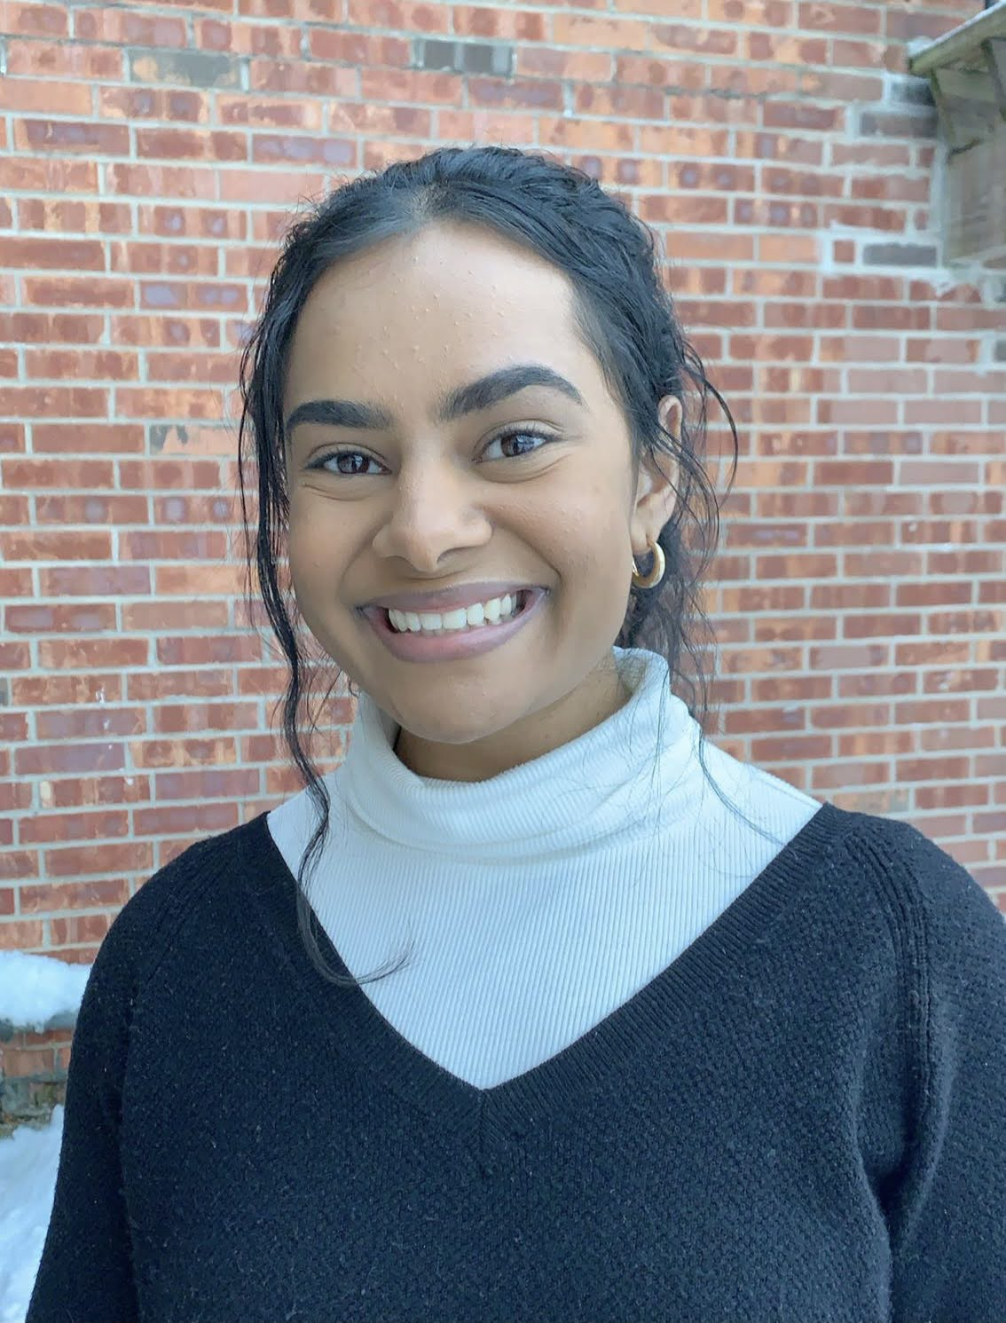
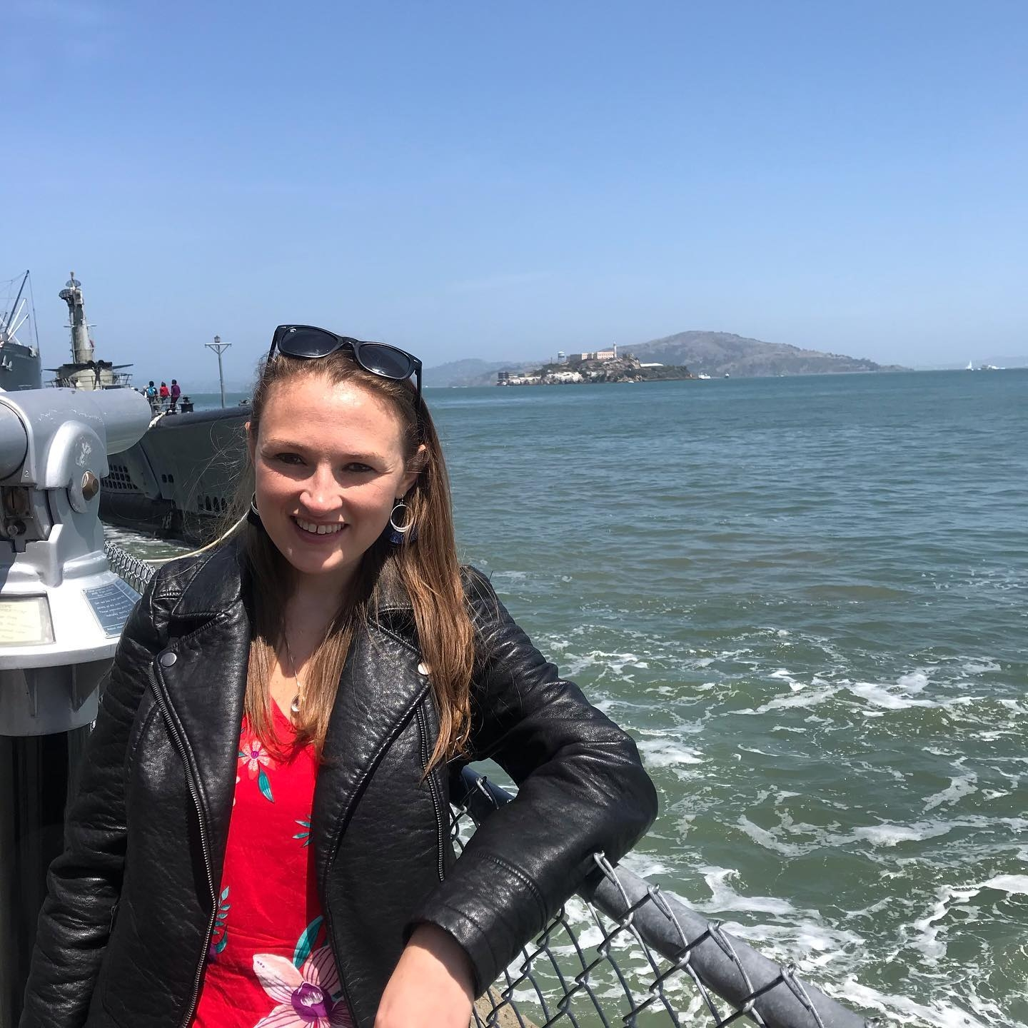
OUR TEAM
SUSAN STANTON
NIKKI
GILLANI
Network Lead
Afterschool Resources & Support Specialist for School Partnerships

Slide 8
—Debbie Stabenow
“Quality after school programs provide safe, engaging and fun learning experiences to help children and youth develop their social, emotional, physical, cultural, and academic skills.”

Slide 9
02
FUNDING

Slide 10
COVID Relief Education Funding
School Districts
ISBE
ISBE State Set Aside
Must spend 20% of funds on learning loss. Afterschool is an allowable use.
Focusing on 4 projects: 1) high impact tutoring, 2) community schools, 3) bridge programs, and 4) assessment
Granted funding to EBF districts for learning loss, summer enrichment, and afterschool
Notes:
https://www.isbe.net/_layouts/Download.aspx?SourceUrl=/Documents/ESSERIII-300m-Set-Aside.xlsx

Slide 11
Other Funding Sources
21st CCLC
Teen REACH
Afterschool Programs
CCAP
Notes:
?? I didn’t want to do too much here since I’m not too well versed in this. Add what you need please!

Slide 12
03
BENEFITS

Slide 13
DEVELOPMENT
These programs are already established and high quality—removes the need to create a brand new service
COMMUNITY
Collaborations can create a stronger community commitment to student academic and social success

Slide 14
24.6 MILLION
In America, for every 1 child in an afterschool program, 3 are waiting to enroll

Slide 15
ADDITIONAL BENEFITS OF AFTERSCHOOL
OST programs offer the following advantages to students and families:
Lessens the achievement gap
Safety
Student mental health
Community engagement

Slide 16
EXAMPLES
70%
60%
89%
OF STUDENTS
OF STUDENTS
OF PARENTS
Improved their behavior with consistent program participation
of children enrolled agree that A.S. programs help them keep their jobs
Improved homework completion and class participation
Notes:
chrome-extension://efaidnbmnnnibpcajpcglclefindmkaj/viewer.html?pdfurl=http%3A%2F%2Fafterschoolalliance.org%2Fdocuments%2FCOVID-recovery-national-Factsheet-020121.pdf&clen=864286&chunk=true

Slide 17
04
HOW-TO

Slide 18
STEPS TO BUILD PARTNERSHIPS
NEEDS
LIST
Create a needs assessment
Compile a list of programs that fit your needs
INTEREST
OUTREACH
AGREEMENT
Gauge interest of students/community
Establish communication with programs
Create terms of the partnership

Slide 19
1. NEEDS ASSESSMENTS
Evaluates the current status of your target community or group. This will review what areas of need are prominent in the target community.
What should be included?
Community demographic data (CMAP)
School data (Teacher surveys; school website)
Student academic attainment (ISBE Report card; teacher/student surveys)
Existing gaps

Slide 20
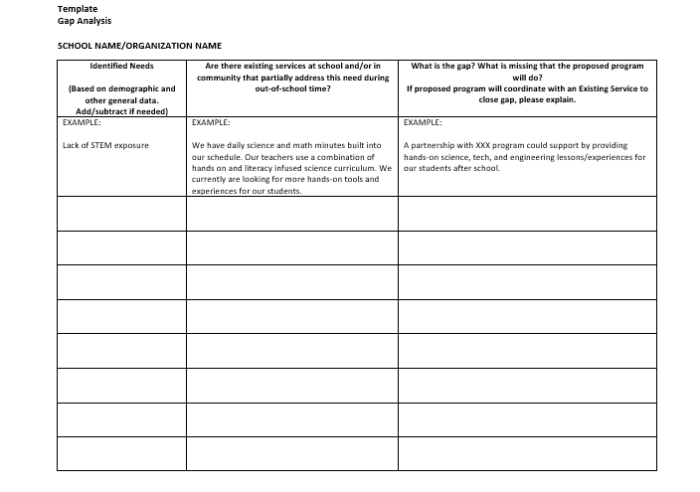
GAP ANALYSIS
!
!

Slide 21
MENTI
What is/are the most pressing needs for your youth?
Notes:
https://www.menti.com/scc81o5dnc

Slide 22
2. LIST ORGANIZATIONS
Base this list off of the gap analysis/needs assessment already created.
Things to remember/consider:
Reflect the culture and values of your students
Family engagement opportunities
Location
Prioritization

Slide 23
TYPES OF PARTNERS
FULL
COLLABORATORS
A “full-time” partner will run your entire OST program (i.e. 21st CCLC).
Collaborative partners would agree to come in 2-3X per week to run a program (i.e. dance class)

Slide 24
ACT Now Map & Database

Slide 25
3. INTEREST
The programs you offer should be of interest to your youth and their families in order to achieve full participation.
How to ensure this:
Surveys
Shared mission

Slide 26
SURVEY PARTICIPATION
CLASS TIME
INCENTIVE
PAPER
REMINDERS
Morning announcements, exit ticket
Raffle, 5 more minutes of recess/free time
Have paper surveys ready to give parents during pick up/drop off
Remind App, emails, homework

Slide 27
4. OUTREACH
After receiving interest information, filter your original program list to include those that fit both needs and interest.
Begin your outreach!
Be sure you fully understand your students’ needs
Know how you want to convey your school’s needs to the organization
Introduce yourself, your school, your students’ needs, how that specific organization can help meet those needs

Slide 28
5. PARTNERSHIP AGREEMENT
This agreement should establish responsibilities for each entity to uphold for the duration of the partnership.
Set clear expectations, goals, responsibilities, oversight, and outcome measures
Exhaust this document
Incentive

Slide 29
STARTING AN AFTERSCHOOL PROGRAM TOOLKIT
This toolkit outlines step-by-step protocol to develop an original afterschool program.
Breakdown:
Before you start
Developing the program
Resource guide

Slide 30
How ACT Now Can Help
Discuss the Needs of Your District
Suggest Partners to Fit Needs
Make Connections to Partners
Ongoing Networking and Training
Notes:
SUSAN

Slide 31
Examples of Partnerships
Possible organizations to run afterschool programming: YMCA’s, Boys and Girls Clubs, Park Districts, other local CBOs
Specific services: mentoring, mental health, nutrition
Curriculum and activities
Trainings for providers

Slide 32
Using Data to Design Afterschool Programs 9/30 10 AM
Notes:
https://attendee.gotowebinar.com/register/8546922113607371020

Slide 33
MENTI
Check-in
Notes:
https://www.menti.com/4mxbnntv17

Slide 34
RESOURCES
Afterschool Alliance Factsheet
Gap Analysis Template
CMAP Community Data Snapshots
ISBE Report Card
ACT Now Map & Database
ACT Now Starting an Afterschool Program Toolkit
Outreach Template

Slide 35
QUESTIONS?

Slide 36
THANKS
Do you have any questions?
stantons@actnowillinois.org
312-877-0725
actnowillinois.org

