Slide 1
CONNECTING WITH COMMUNITY PARTNERS
October 25, 2022
Notes:
NG

Slide 2
AGENDA
01
03
02
04
INTRODUCTION
USING ESSER III TO PARTNER
Meeting norms, ACT Now, PFR, facilitators, recap
Allocation update, accessing funding, steps
BENEFITS OF PARTNERING
SUCCESSFUL PARTNERSHIPS
Types of partnerships and advantages
Pillars of establishing a successful partnership
Notes:
NG

Slide 3
MEETING NORMS
01
02
03
ENGAGE!
LISTEN!
SHARE!
Actively engage with us and one another. When you feel comfortable, keep your camera on
Actively listen to and respect each others’ experiences and shares
Interact and share using the Zoom platform (i.e., unmute, reactions, chatbox)
Notes:
NG

Slide 4
ACT NOW
Afterschool for Children and Teens Now (ACT Now) is a statewide coalition that works to ensure there are high-quality, affordable afterschool/OST programs available for youth across the state of Illinois.
Advocacy
Connecting Stakeholders
Professional Development
Technical Assistance
Notes:
NG

Slide 5
Partnership for Resilience
The Partnership for Resilience works to improve academic, health, and social outcomes for children by fostering trauma-responsive schools and effective family, school, health, and community partnerships.

Slide 6
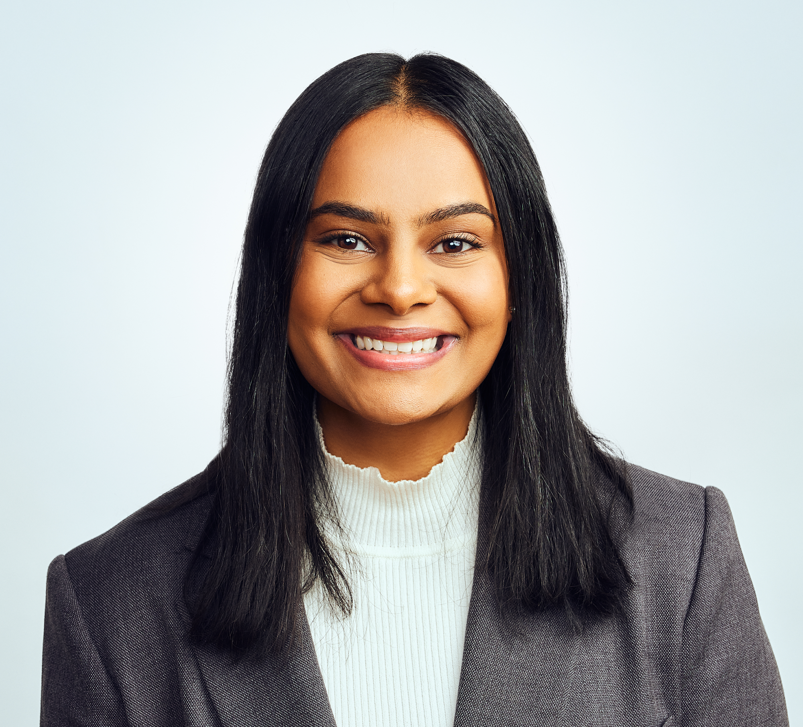
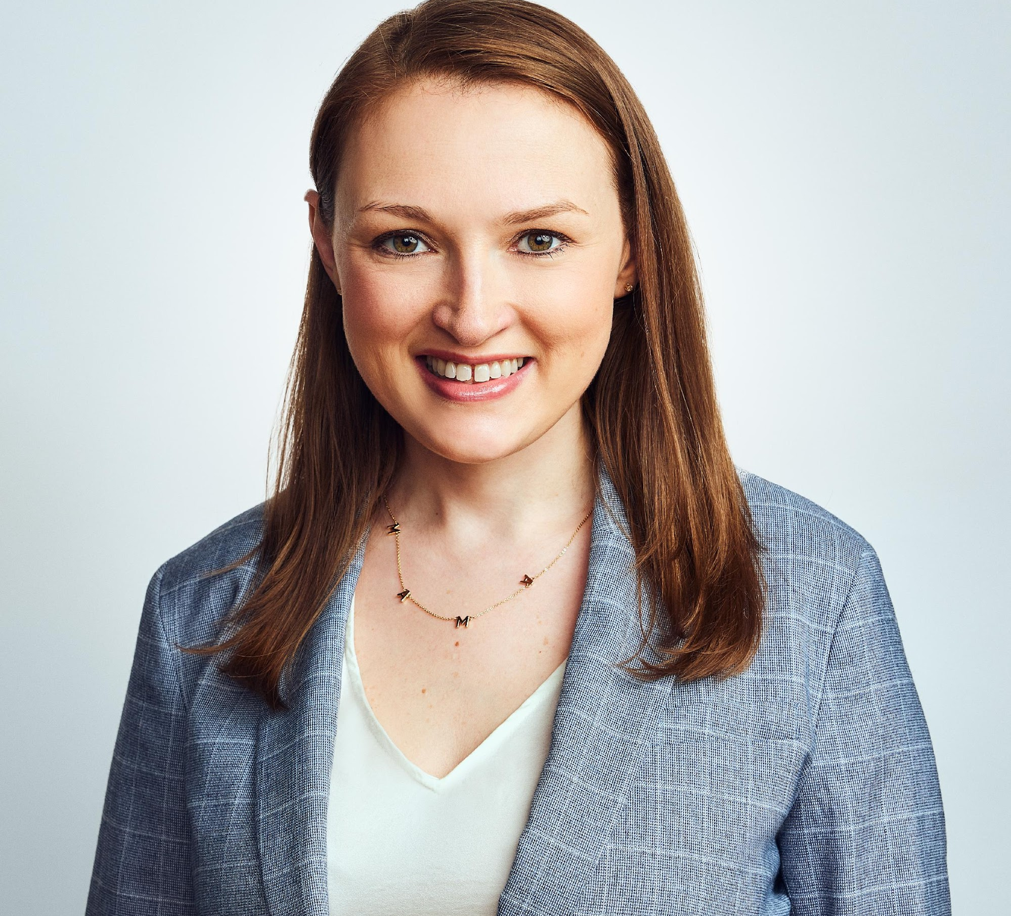
FACILITATORS
NIKKI GILLANI
SUSAN STANTON
KRISTINE ARGUE-MASON
she/her
she/her
Afterschool Resources & Support Specialist (School Partnerships)
she/her
Executive Director
Partnership for Resilience
Network Lead
Notes:
NG, SS, KAM
Icebreaker question: if you could have any superpower, what would it be and why?

Slide 7
01
RECAP
Notes:
NG

Slide 8
PURPOSE
Alert and inform school districts of the opportunities available to expand afterschool using COVID relief funding.
Network and share best practices or opportunities to collaborate in the youth development field.
Notes:
NG

Slide 9
SERIES GOALS
01
ESTABLISH A BASELINE
02
LEARN HOW TO LEVERAGE RESOURCES
03
CREATE SUSTAINABLE OPPORTUNITIES FOR YOUTH
Understand the current state of afterschool in Illinois
Utilize available community partners and funding to expand afterschool
Prepare for programming post ARP funding
Notes:
NG

Slide 10
SERIES OVERVIEW
SEPT. 22, 2022
OCT. 25, 2022
AUGUST 31, 2022
NOV. 30, 2022
JANUARY 4, 2023
FEB. 23, 2023
The Scope of Afterschool in Illinois
Designing Programming with a Needs Assessment and Asset Mapping
Connecting With Community Partners
Sustainability Planning for After ESSER Funding
Curricula and Activities
Program Assessment
Notes:
NG

Slide 11
COVID RELIEF EDUCATION FUNDING
School districts must spend 20% of ARP funds on learning loss
Afterschool is an allowable use!
ISBE’s projects through ESSER II & III:
High impact tutoring; community schools; bridge programs; assessment
ISBE granted funding to EBF districts for learning loss, summer enrichment, and afterschool
Notes:
NG
https://www.isbe.net/Documents/ESSER-Fact-Sheet.pdf
ESSER fact sheet

Slide 12
NEEDS AND ASSETS
ASSETS
NEEDS
PARTNERSHIPS
Gaps to positive youth development (academic or social-emotional) that exist within the serviced community.
Resources available within the target community that can be leveraged to meet needs.
Notes:
NG

Slide 13
02
BENEFITS OF PARTNERING
Notes:
NG

Slide 14
01
INFRASTRUCTURE
COMMUNITY
02
Partnering entities have established, high-quality programming. This removes the need to develop a brand-new service.
Collaborations can create a stronger community commitment to students academic and social success.
03
COMPETITION
SUSTAINABILITY
04
Eliminate competition through partnerships. Don’t compete for staff, students, and resources with already existing programs.
Partnerships can help keep programs going after ESSER funding is gone! (learn more about this in next month’s presentation)
Notes:
NG

Slide 15
THE BOTTOM LINE
2,787,723
1:4
JUPITER
696,931
School-aged youth in Illinois
For every child in an afterschool program, 4 youth are waiting to get in one
Youth are still waiting for programming
We are not serving enough youth.
Notes:
NG

Slide 16
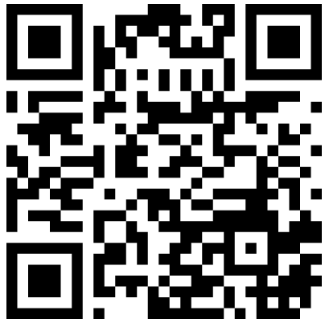
MENTI
Notes:
https://www.menti.com/alkvs8k71pic
What is your biggest struggle in forming partnerships? (short answer)

Slide 17
03
USING ESSER FUNDING TO PARTNER
Notes:
NG

Slide 18
ALLOCATION UPDATE
788 out of 939 entities have approved applications
67 entities totaling $129,272,599 have NOT applied
419 school districts have expended $0 (7/25/22)
Notes:
NG
https://public.tableau.com/app/profile/edunomicslab/viz/IllinoisESSERIIIAllocationFundsSpent/Dashboard1

Slide 19
OVERALL ESSER SPENDING
ESSER Funds Summary - State of IL – LEA (90%) – As of 9/28/22
Fund | $ Allocated | $ Expended | $ Unexpended | % Expended | Obligation By | Liquidation By
ESSER I | $ 512,520,496 | $ 504,400,321 | $ 8,120,175 | 98.4% | 9/30/2022 | 1/28/2023
ESSER II | $ 2,025,724,402 | $ 1,583,690,907 | $ 442,033,495 | 78.2% | 9/30/2023 | 1/28/2024
ESSER III* | $ 4,856,233,714 | $ 944,910,483 | $ 3,911,323,231 | 19.5% | 9/30/2024 | 1/28/2025
Total | $ 7,394,478,612 | $ 3,033,001,711 | $ 4,361,476,901 | 41.0% | --- | ---
Notes:
NG
From ISBE

Slide 20
CURRENT STATE OF OST PARTNERSHIPS
Only 1 in 5 program providers report receiving COVID relief funds nationwide
21st CCLC providers are MUCH more likely to be reached out to by LEAs than non-21st CCLC programs
Only 31% of school-based entities that received funding have partnered with a CBO
Providers with access to COVID relief funding have reported this funding has helped with:
Staff recruitment
Hire more staff
Serve more students
Expand program offerings
Notes:
NG
http://afterschoolalliance.org/documents/How-COVID-Relief-Funding-is-a-Lifeline-Wave-7.pdf

Slide 21
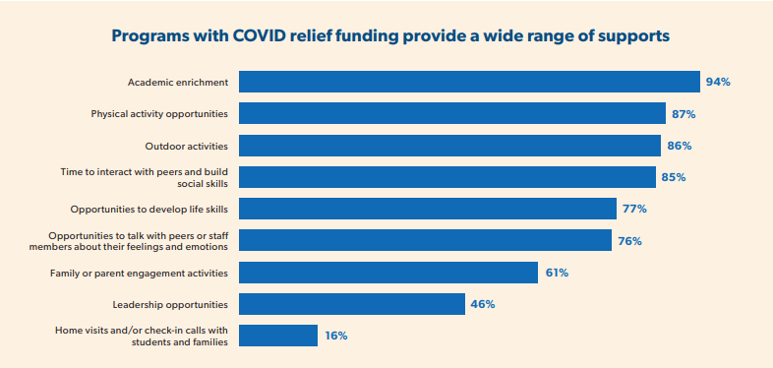
Notes:
NG

Slide 22
ACCESSING FUNDING
IWAS
PLANS
REPORTING
If you haven’t already, log into IWAS and submit your application to access the funding allocated to your school district
Submit a spending plan to ISBE within 90 days of receiving funding. This plan must also be available on your district website!
Reporting from LEAs is required semi-annually. These reports will detail specific intervention strategies funding was used for.
Notes:
NG
Instructions and more information here: https://www.isbe.net/Documents/ESSER-III-webinar-presentation.pdf

Slide 23
STEPS TO PARTNERING
RESEARCH
PLAN
OUTREACH
Evaluate your needs
Find your local assets
Identify any other funding streams programs have
Create a partnership proposal—think about what the partnership should look like
Reach out to providers in your area and pitch a partnership!
Ask for a meeting to discuss your proposal
Notes:
NG
Connecting School Districts to Community Partners webinar: https://register.gotowebinar.com/recording/8877211009912228363

Slide 24
MANAGEMENT
Resource Coordinator
Responsible for managing partnerships
Communicates with administration, teachers, caregivers, partnering entities, OST staff
Benefits
Direct support to programming
Bridge between community and school
Consistency
Management practices
Partnership ideals
Information rollout

Slide 25
MENTI
Notes:
https://www.menti.com/alkvs8k71pic
What types of partners do you have for various needs?

Slide 26
TYPES OF PARTNERSHIPS
Enrichment Partnerships
Statewide Partnerships
Health Partnerships
Locally-based organizations
STEM
Libraries, community centers, senior communities/residencies
Statewide YMCAs
Boys and Girls Clubs of America
4-H Extension
County health department
Clinics
Local colleges and universities
Notes:
NG

Slide 27
MAP ACTIVITY
Use ACT Now’s Map and Database to find potential partner organizations.
Criteria:
Location: Sangamon County
Age Group: Elementary age (1st-6th grade)
Services: Homework assistance, STEM, and mentoring
Notes:
NG
https://map.actnowillinois.org/map
7 minutes
Drop in chat the partners you have found in this area

Slide 28
04
SUCCESSFUL PARTNERSHIPS
Notes:
KAM -

Slide 29
What skills do you hope the high school class of 2023 gains as they enter the world of work or higher education?
Class of 2023
Notes:
Have participants respond in the chat
Process out loud

Slide 30
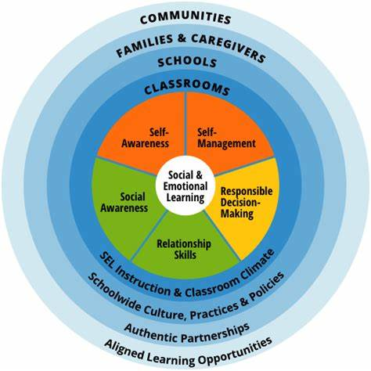
COLLABORATIVE for SOCIAL EMOTIONAL LEARNING
YOU
YOU & ME
YOU, ME & EVERYBODY ELSE
Notes:
The conversations around SEL and whose responsibility it is for teaching those skills to our students has been incorrectly and almost exclusively placed with schools and parents.
Community organizations are waiting to stand in partnership with classrooms, schools, families and caregivers to provide aligned learning opportunities. What are those aligned learning opportunities - the You, the you & me, and the you, me & everybody else.
Colleges and universities, youth development organizations, libraries, museums, city parks, faith based organizations, community for profit organizations and community non-profit organizations exist to provide a strong, divers partnership within a given community.

Slide 31
PILLARS OF A SUCCESSFUL PARTNERSHIP
01
03
02
04
RECIPROCAL COMMUNICATION
CLEAR ROLES, EXPECTATIONS, RESPONSIBILITIES
SHARED VALUES & MISSION
COLLABORATIVE LEADERSHIP
Notes:
KAM - Successful partnerships start with designating a person within your district (like that resource coordinator) to work with community based organizations to navigate in the educational community space. That point person within your district will preserve and promote timely and effective use of resources offered by community partners.

Slide 32
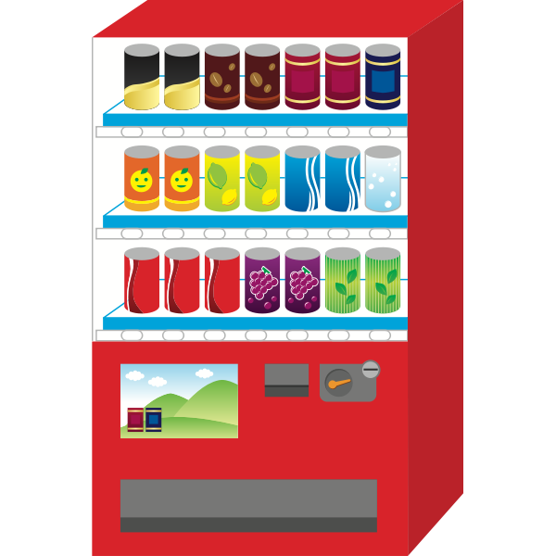
Relational vs Transactional
Notes:
The relationship should be viewed as a partnership versus a vendor merely providing services. This requires reciprocal communication. The relationship building that takes place within the community when stories are shared about successes builds capacity within the community to do even more for the students we serve.

Slide 33
Community organizations have the capacity and the opportunity to provide experiences that are unique and meaningful to our communities.
Notes:
Make yourselves aware of the VALUES & MISSION of the organizations that you wish to partner with or who wish to partner with you. Having shared values and mission allow for the leveraging of assets to do more for our students.

Slide 34
Be intentional about establishing a clear blueprint for the work that you will do in partnership.
Notes:
Taking the time to openly communicate with community partners is paramount. Clearly identify roles - take nothing for granted. Create a memorandum of understanding. Contrary to what some may believe, that MOU can exist without monetary stipulations. Take time to communicate with each other regarding the scope of work, the expectations and delegated responsibilities for the partnership. Being explicit about clear roles, expectations and responsibilities strengthens the partnership.

Slide 35
Shared Vision
Notes:
As noted in the CASEL framework, it is not the sole responsibility of the “School House” and parents to meet every need for youth. As we continue to move through this pandemic, working together with partners that were in your community prior to the pandemic and likely to be there once the overflowing of relief dollars fade away, fosters the sustainability needed to provide what we all want for the young people in our communities. Shared vision, or at least a shared understanding of the vision within a partnership is critical to the success of working together. That shared vision leads to collaborative leadership.

Slide 36
RESOURCES
ISBE Title Grants Page
ISBE Instructions for Applying and Using ESSER Funding
Ideas on Partnerships
Reaching Out to SDs Toolkit
Connecting SDs to CBOs Presentation
Edunomics Illinois Expenditure Report
Notes:
NG

Slide 37
UPCOMING EVENTS
21st CCLC Town Hall
SEL Webinar 1
October 26, 2022
10am-11am
November 17, 2022
10am-11am
Notes:
NG

Slide 38
SUSTAINABILITY PLANNING FOR AFTER ESSER FUNDING
November 30, 2022
Notes:
NG

Slide 39
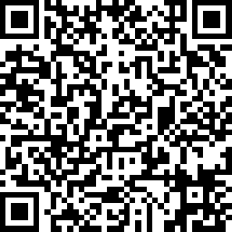
EVALUATION
Fill this out for a $10 Target gift card!
Notes:
NG
https://www.surveymonkey.com/r/WP39Z8R

Slide 40
THANKS
Do you have any questions?
Nikki Gillani
gillanin@actnowillinois.org
312 714 0182
Kristine Argue-Mason
kargue-mason@partnership4resilience.org
708 539 9927
Please keep this slide for attribution
Notes:
NG

