Slide 1
Grant Writing: Unpacking a NOFO & Needs Assessments
March 1, 2022

Slide 2
Agenda
01
02
03
04
Introduction
Series Expectations
ACT Now, who is on the call?
What this series will look like and learning outcomes.
Unpacking a NOFO
Needs Assesments
Reading a NOFO, note-taking, and action plans
What is a needs assessment and how to create one.

Slide 3
01
Introduction

Slide 4
Who is ACT Now
ACT Now is a statewide coalition that works to ensure that youth across Illinois have access to affordable, high quality programs afterschool. We do this by advocating for afterschool programs at the local, federal, and state levels, developing and facilitating professional development opportunities for providers, pursuing and sharing new funding opportunities, and by connecting schools and CBOs to establish lasting partnerships.

Slide 5
Get to Know You Polls!
Notes:
Program type
CBO
School
Home
Faith-based
Other
What is your experience with grant writing?
None
Little
Some
A lot
What does your capacity look like?
Low capacity (no team or 1-2 team members)
Medium capacity (2-3 team members)
High capacity (3-5 team members)
Unsure

Slide 6
Series Expectations
02
Topics, overview, and learning outcomes

Slide 7
Series Topics
Unpacking & Needs
Program Model
Goals & Objectives
Budget
Program delivery; credibitliy; capacity; community
Using program model to create this; attributable vs. inappropriate costs
Using a NOFO to guide planning; how to write a needs assessment
Using the RFP and N.A. to guide these; evaluation methods

Slide 8
Learning Outcomes
Series Topic | Outcome 1 | Outcome 2 | Outcome 3
Unpacking & Needs | Assess team capacity | Action plan | Gap analysis representative of your community
Program Model | Assess org. capacity | Organize a management plan | Identify program structure
Goals & Obj. | Types of success | Goals vs. objectives | Methods & tools for evaluation
Budget | Learn the parts of a UGB | Discuss budget components | Outline a budget narrative
Notes:
These are WORKING sessions. There will be accompanying worksheets and documents for you all to fill out as we are in this session so that you walk away with tangible tools that prepare you for upcoming NOFOs. Throughout these sessions there are opportunities for engagement and share outs through menti meters and jamboards that will enhance your learning experience—please participate in these opportunities.

Slide 9
03
Unpacking a NOFO
What should you be looking at?
Notes:
Explain NOFO and RFP acronyms

Slide 10
ISBE Nita M. Lowey 21st CCLC RFP
Notes:
https://www.isbe.net/Pages/21st-Century-Community-Learning-Centers.aspx

Slide 11
Preparation and First Steps
Read the ENTIRE RFP!
Focus areas to guide planning and assessing capacity
Eligibility Requirements and Priority Areas
(page 1 & 11)
Program Narrative Requirements
(page 39)
Review Criteria
(page 47)
Who can apply
Language
Need, project, family and community engagement, organizational/agency experience and capability
Bonus points!
Expectaions of reviewers
This will take the longest!
Additional priority information (tiebreaker, similar proposals)

Slide 12
Assessing Capacity
Team Members
Narrative
Time
How many team members do you have?
Where do their strengths lie (writing, description, planning, administrative work)
What can you readily answer that is asked for in the narrative?
What will you need to develop?
How can you demonstrate capability?
How much time do you have to submit?
What other commitments does your team have?

Slide 13
Action Plan
Steps | March | 1 | 2-4 | 5-7 | 8-10 | 11-13 | 14-17 | 18-21 | 22-25 | 26-28
1. Prep & Take Notes
2. Designate Roles; Fill Application; Comm. Notif.; Contact Partners
3. Need—Develop Surveys & Find Supplemental Resources
4. Survey Dissemenation & Collect Results; Letters of Support Due
5. Narrative: needs; project/program plan; sustainability plan
6. Goals; evaluation plan; budget
7. Budget review and revisions
8. Final checks and submission
Team Meeting
Team Meeting
Team Meeting

Slide 14
04
Needs Assessments
What is this and how to do it

Slide 15
Needs Assessments Basics
What is it?
Evaluates the current status of your target community or group. This will review what areas of need are prominent in the target community and allow you to prioritize goals.
Importance
Identify what gaps are contirbuting to stunted community growth and upward social mobility. Allows for the development of clear and defined goals that align with pressing needs.

Slide 16
Conducting an Assessment
Identify Project Interventions
Community Outreach
Ask the anticipated impacted audience their needs
Use the project described in the NOFO to know what priority areas to assess
Supplemental Research
Gap Analysis
Use collected infromation to identify where gaps lie and where to intervene
Use trusted databases to collect additional information and supplement outreach results

Slide 17
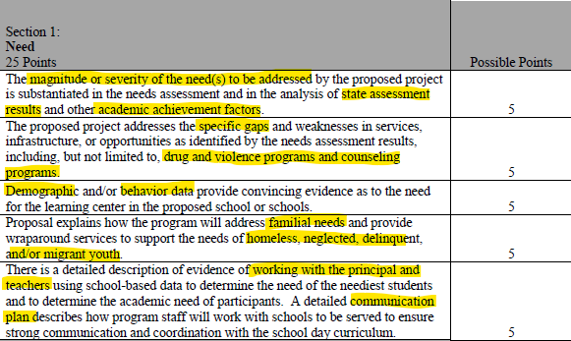
Needs Review Criteria

Slide 18
What to include
Community demographics
Prevalence of risk factors
Academic attainment
Impact of proposed program
21st CCLC prioritizes academic achievement—this is CRITICAL to include

Slide 19
Data Types and Resources
Type | Resources
Community Demographics | CMAP | Census Data
Academic Attainment | ISBE Report Card | District Website (Strategic Plan) | Teacher Surveys
Risk Factors | Police Department Incident Reports | AECF—Kids Count Data Book | Health Atlas
Engagement Levels | Student surveys | Parent surveys | Community surveys
Notes:
https://actnowillinois.org/afterschool-and-school-district-partnerships/

Slide 20
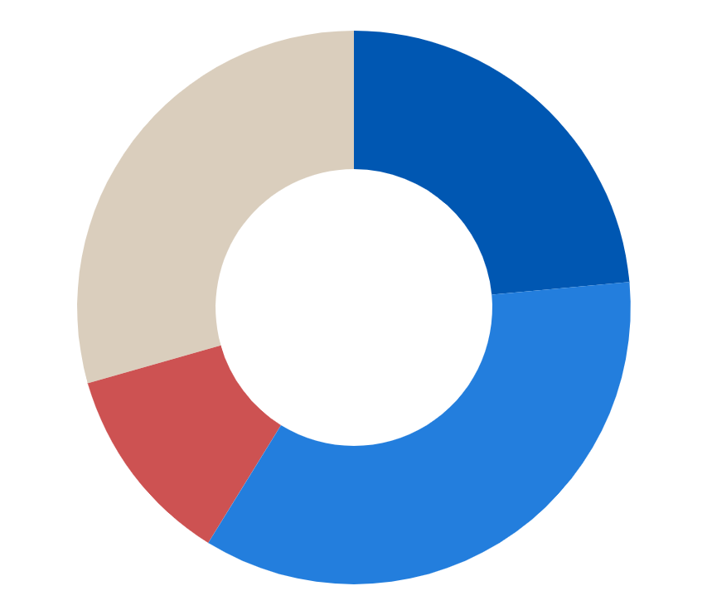
Interpreting the Data
60%
22%
Students
Principals
Need help to complete homework daily
Bullying is a prominent issue
10%
40%
Parents
Teachers
No barriers to send child to OST program
Identified “Homework Help/Tutoring” as a very important need
Priorities: Homework help, resotrative practices, increasing accessibility to program (time, transportation, interest)
Notes:
Note: priorities are transitioned. First launch menti to assess what priorities are mentioned from this data.
https://www.menti.com/6p2cib9rku

Slide 21
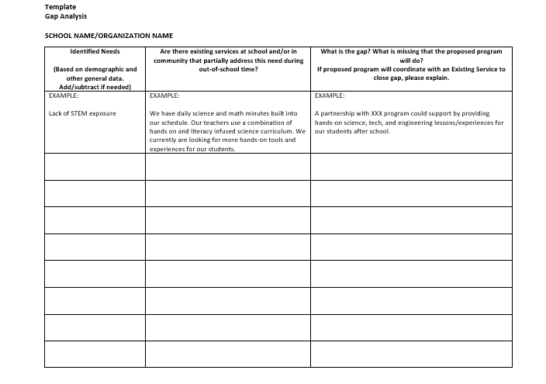
Gap Analysis
Notes:
Working time—fill out individually, share out through jamboard
https://jamboard.google.com/d/1oevTCrwoOL-sR6kyqf7cJnUQrrFdLUds2tqxNHd_wDE/edit?usp=sharing

Slide 22
Timer

Slide 23
Upcoming Funding Opportunities

Slide 24
Upcoming NOFOs
RPSA-YD
21st CCLC
NOFO out now!
ACT Now One-Pager
Possible competition in March.
FY13 Cohort reapply
Afterschool Programs
Full Service CS
Fingers-crossed for a competition next school year!
NOFO out NOW!
Annual application process.

Slide 25
Questions?

Slide 26
Thanks!
Do you have any questions?
gillanin@actnowillinois.org
(312) 714-0182
Actnowillinois.org

