Slide 1
Grant Writing: Program Model & Design
March 2, 2022

Slide 2
Series Topics
Unpacking & Needs
Program Model
Goals & Objectives
Budget
Program delivery; credibitliy; capacity; community
Using program model to create this; attributable vs. inappropriate costs
Using a NOFO to guide planning; how to write a needs assessment
Using the RFP and N.A. to guide these; evaluation methods

Slide 3
Agenda
01
02
03
04
Recap
Learning Outcomes
Review of yesterday’s session and materials
What to expect from today’s session
Plan and Assess
Design
Developing programmatic vision based on capacity
Establishing a progam design

Slide 4
01
Recap

Slide 5
ISBE Nita M. Lowey 21st CCLC RFP
Notes:
https://www.isbe.net/Pages/21st-Century-Community-Learning-Centers.aspx

Slide 6
Finished action plan
Steps | March | 1 | 2-4 | 5-7 | 8-10 | 11-13 | 14-17 | 18-21 | 22-25 | 26-28
1. Prep & Take Notes
2. Designate Roles; Fill Application; Comm. Notif.; Contact Partners
3. Need—Develop Surveys & Find Supplemental Resources
4. Survey Dissemenation & Collect Results; Letters of Support Due
5. Narrative: needs; project/program plan; sustainability plan
6. Goals; evaluation plan; budget
7. Budget review and revisions
8. Final checks and submission
Team Meeting
Team Meeting
Team Meeting

Slide 7
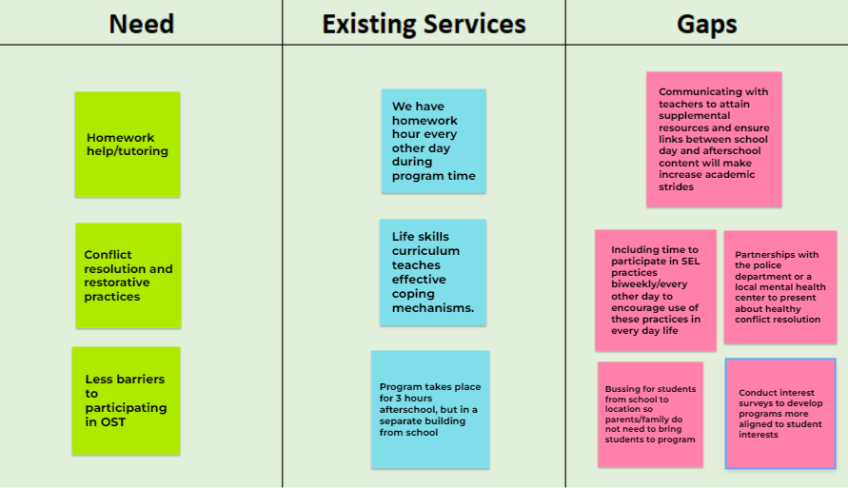
Finished gap analysis

Slide 8
Polls
Notes:
The tools from yesterday’s session were helpful
Yes
Sort of
No
I like having the opportunity to work within these sessions
Yes
Sort of
No

Slide 9
Learning Outcomes
02
What to expect out of today’s session

Slide 10
Learning Outcomes
Series Topic | Outcome 1 | Outcome 2 | Outcome 3
Unpacking & Needs | Assess team capacity | Identify key stakeholders and partners | Gap analysis representative of your community
Program Model | Assess org. capacity | Organize a management plan | Identify program structure
Goals & Obj. | Types of success | Goals vs. objectives | Methods & tools for evaluation
Budget | Learn the parts of a UGB | Discuss budget components | Outline a budget narrative
Notes:
These are WORKING sessions. There will be accompanying worksheets and documents for you all to fill out as we are in this session so that you walk away with tangible tools that prepare you for upcoming NOFOs. Throughout these sessions there are opportunities for engagement and share outs through menti meters and jamboards that will enhance your learning experience—please participate in these opportunities.

Slide 11
03
Plan and Assess
Developing programmatic vision based on capacity

Slide 12
Project Review Criteria

Slide 13
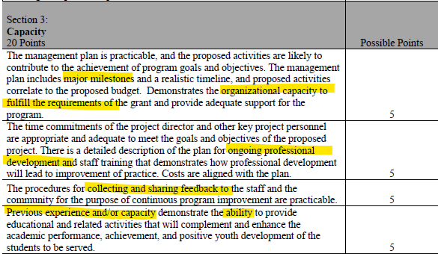
Project Review Criteria

Slide 14
What to include
Page 40
1 | Basic program info (times, days, location, frequency, # of students) | 6 | Partnerships (what your partners will provide, sustainability plan)
2 | Strategies (recruitment, retention, communication) | 7 | Professional development (onboarding, planned topics, frequency, funding)
3 | Services to be provided and rationale (inlcude equitable access and evidence-based practices) | 8 | Management plan
4 | Job decriptions and roles | 9 | Organizational history (past experience, standing in the community)
5 | Family and community engagement efforts | 10 | Capacity and capability

Slide 15
Worksheet

Slide 16
Timer

Slide 17
Assessing Capacity
Available
What does our agency already do that can meet identified needs?
Create
What needs to be developed to further meet these needs?
Ability
What do we have the ability and capacity to create? (keep in mind staffing, resources, partnerships, funding)
Notes:
Use the completed gap analysis to guide this

Slide 18
Assessing Capacity
Projected # of staff | 8 (1 SC; 5 YDS; 1 Academic Coord.; 1 SG) | Projected # of program areas | 6 | # of program hours/day | 3
Student program interest level |  |  | Change impact
Grade levels |  | New programs |  | Resources
3rd, 4th, 5th, 6th, 7th, 8th |  | Conflict res., STEM, wellness |  | Partner 1 Partner 2 Partner 3 LAC? YAB?
Principal | Jane Doe | Site Coord. | James Cox
Low
Medium
High
Notes:
Another method of assessing capacity—building out your program
Program areas:
-health and wellness
-academics/homework help
-mentoring
-sports & recreation
-STEM
-conflict resolution/restorative justice

Slide 19
Management Plan
Time | Milestone | Tasks
July 2022 | Site Coordinator(s) are hired | Post Coordinator job postings (HR) Marketing strategies for student and staff recruitment (HR)
Aug. 2022
Sept. 2022
Planning tool that designs the future of your program based on the aims and objectives.
Remember to include:
Major milestones
Timeline
Project goals
Staff involved in tasks/milestones
Notes:
Use understanding of capacity to build this
Jamboard? For august and sept.

Slide 20
04
Program Design

Slide 21
Identify your key needs

Slide 22
Academic Progress
Restorative Practices
Health & Rec.

Slide 23
Identify your partners
Notes:
What will your partners provide to help you fill gaps and increase capacity?
How often will partners implement programming/provide resources?

Slide 24
Design Your Program
Frequency vs length of program
How often will you offer programs in your high need areas?
Time in each program area?
Program Delivery
Virtual; in-person; hybrid
Additional program areas
Use survey results to determine these
Family Engagement
Frequency/day of the week
Time
Length
Activities
Age groups
How will youth be split up?
Notes:
Program areas (as listed in the capacity assessment slide)
-health and wellness
-academics/homework help
-mentoring
-sports & recreation
-STEM
-conflict resolution/restorative justice

Slide 25
Example Program Schedule
Time | Key: | 3rd – 4th |  | 5th – 6th | 7th -8th
3:30-4:00pm | Arrival & Attendance Snack | $320 |  | $300
4:00-4:45pm | Health & Wellness | Medium | Homework Help | STEM | STEM
4:45-5:30pm | Health & Wellness | 18-45 | STEM | Homework Help | Homework Help
5:30-6:15pm | Health & Wellness | Average | Health & Wellness | STEM | Homework Help
6:15-6:30pm | Dismissal | Italy | Italy | America
- 8th

Slide 26
Example Program Schedule
Time | Key: | 3rd – 4th |  | 5th – 6th | 7th -8th
3:30-4:00pm | Arrival & Attendance Snack | $320 |  | $300
4:00-4:45pm | Physical Recreation | Medium | Conflict Resolution | Homework Help | Homework Help
4:45-5:30pm | Homework Help | 18-45 | Conflict Resolution | Physical Recreation | Physical Recreation
5:30-6:15pm | Conflict Resolution | Average | Conflict Resolution | Physical Recreation | Homework Help
6:15-6:30pm | Dismissal | Italy | Italy | America
- 8th

Slide 27
Upcoming Funding Opportunities

Slide 28
Upcoming NOFOs
RPSA-YD
21st CCLC
NOFO out now!
ACT Now One-Pager
Possible competition in March.
FY13 Cohort reapply
Afterschool Programs
Full Service CS
Fingers-crossed for a competition next school year!
NOFO out now!
Annual application process.

Slide 29
Questions?

Slide 30
Series Topics
Unpacking & Needs
Program Model
Goals & Objectives
Budget
Program delivery; credibitliy; capacity; community
Using program model to create this; attributable vs. inappropriate costs
Using a NOFO to guide planning; how to write a needs assessment
Using the RFP and N.A. to guide these; evaluation methods

Slide 31
Thanks!
Do you have any questions?
gillanin@actnowillinois.org
(312) 714-0182
Actnowillinois.org

