Slide 1
Grant Writing: Goals & Objectives and Evaluation
March 3, 2022

Slide 2
Series Topics
Unpacking & Needs
Program Model
Goals & Objectives
Budget
Program delivery; credibitliy; capacity; community
Using program model to create this; attributable vs. inappropriate costs
Using a NOFO to guide planning; how to write a needs assessment
Using the RFP and N.A. to guide these; evaluation methods

Slide 3
Agenda
01
02
03
04
Recap
Learning Outcomes
Review of yesterday’s session and materials
What to expect from today’s session
Creating Goals & Objectives
Evaluation Plan
How to create a meaningful evaluation plan
Using the NOFO and program design to establish goals and objectives

Slide 4
01
Recap

Slide 5
ISBE Nita M. Lowey 21st CCLC RFP
Notes:
https://www.isbe.net/Pages/21st-Century-Community-Learning-Centers.aspx

Slide 6
Capacity Assessment
Projected # of staff | 8 (1 SC; 5 YDS; 1 Academic Coord.; 1 SG) | Projected # of program areas | 6 | # of program hours/day | 3
Student program interest level |  |  | Change impact
Grade levels |  | New programs |  | Resources
3rd, 4th, 5th, 6th, 7th, 8th |  | Conflict res., STEM, wellness |  | Partner 1 Partner 2 Partner 3 LAC? YAB?
Principal | Jane Doe | Site Coord. | James Cox
Low
Medium
High

Slide 7
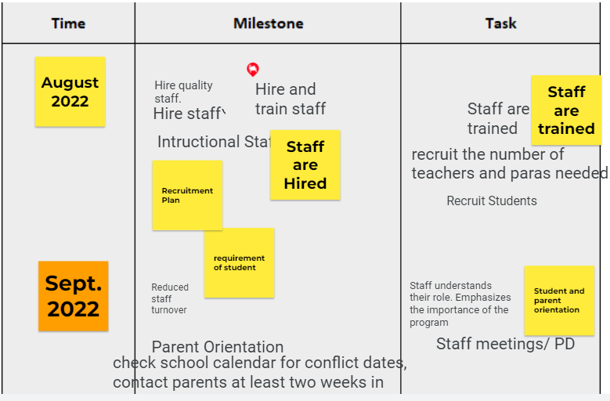
Management Plan

Slide 8
Learning Outcomes
02
What to expect out of today’s session

Slide 9
Learning Outcomes
Series Topic | Outcome 1 | Outcome 2 | Outcome 3
Unpacking & Needs | Assess team capacity | Identify key stakeholders and partners | Gap analysis representative of your community
Program Model | Assess org. capacity | Organize a management plan | Identify program structure
Goals & Obj. | Types of success | Goals vs. objectives | Methods & tools for evaluation
Budget | Learn the parts of a UGB | Discuss budget components | Outline a budget narrative
Notes:
These are WORKING sessions. There will be accompanying worksheets and documents for you all to fill out as we are in this session so that you walk away with tangible tools that prepare you for upcoming NOFOs. Throughout these sessions there are opportunities for engagement and share outs through menti meters and jamboards that will enhance your learning experience—please participate in these opportunities.

Slide 10
03
Creating Goals & Objectives

Slide 11
Goals vs. Objectives
Goals
Objectives
General statement of what you want to achieve.
Define strategies or steps to take to attain the identified goals.
Example:
Example:
To be able to do the splits.
15-minute full body stretch every morning for 1 month
Hip mobility routine before every workout for 1 month
Practice splits after mobility routine and stretches

Slide 12
Resources to Guide Goals
Program Objectives
Performance Measures
Program Design
Greatest areas of intervention
Purpose of program as intended in the RFP
Pg. 8
Intended outcomes of the program
Pg. 10
Notes:
Note that these will help differentiate outputs vs outcome measures of success

Slide 13
Goals & Objectives
Objective 1
Objective 4
Objective 2
Goal
Objective 3

Slide 14
Goals & Objectives
Objective 1
Objective 4
20% of regular participants will show a 10% increase in homework completion.
Objective 2
Objective 3
Notes:
Jamboard to create objectives https://jamboard.google.com/d/15TuAX07lgeQCJab2hg_NsDL97pWjAZPs2QsVAAkX9Vs/edit?usp=sharing
Also include a worksheet for goals/objectives

Slide 15
Timer

Slide 16
04
Evaluation Plan

Slide 17
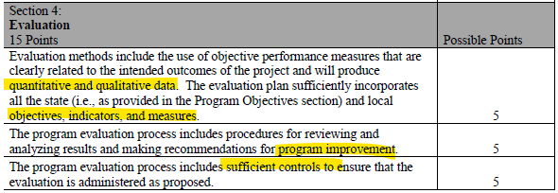
Evaluation Review Criteria

Slide 18
Types of Success
Outputs
Record the actual services that a program delivered
Outcomes
Indicates progress towards achieveing the intended result of a program.
Notes:
Your goals and objectives will determine which of these you use

Slide 19
Example
Goal:
20% of regular participants will show a 10% increase in homework completion.
Success:
(outcome)
At the end of Q1, 7% of participants increased homework completion.

Slide 20
Impact of Evaluation
Successes, challenges, areas of growth, progress towards intended goals, important intervention areas, effectiveness of implementation strategies, quality of staff

Slide 21
What to include
External Evaluator
Specific Questions
When possible, use an external evaluator. Reduces bias and allows for more fidelity in evaluations.
Include questions that are linked to the defined goals and objectives
Stakeholder Feedback
Assessment Data
Report cards, state assessments, progress reports
Allow your partners and members of the community to evaluate impact

Slide 22
IL Afterschool Quality Standards

Slide 23
Jamboard
Evaluation Results
Notes:
Who would review your evaluations/be a part of the review team?
How would change be administered within programming? (i.e., advising staff to participate in PD for XYZ topics)
https://jamboard.google.com/d/15TuAX07lgeQCJab2hg_NsDL97pWjAZPs2QsVAAkX9Vs/edit?usp=sharing

Slide 24
Evaluation Tools
IL-QPSA
YPQI
REL’s Toolkit
Online strengths-based self-assessment tool based on the IL Afterschool Quality Standards
Evaluation tool that identifies program strengths and challenges, ending with an improvement plan
Step-by-step process for conducting your own program evaluation.

Slide 25
Upcoming Funding Opportunities

Slide 26
Upcoming NOFOs
RPSA-YD
21st CCLC
NOFO out now!
ACT Now One-Pager
Possible competition in March.
FY13 Cohort reapply
Afterschool Programs
Full Service CS
Fingers-crossed for a competition next school year!
NOFO out now!
Annual application process.

Slide 27
Questions?

Slide 28
Series Topics
Unpacking & Needs
Program Model
Goals & Objectives
Budget
Program delivery; credibitliy; capacity; community
Using program model to create this; attributable vs. inappropriate costs
Using a NOFO to guide planning; how to write a needs assessment
Using the RFP and N.A. to guide these; evaluation methods

Slide 29
Thanks!
Do you have any questions?
gillanin@actnowillinois.org
(312) 714-0182
Actnowillinois.org

