Slide 1
Grant Writing: Budget and Budget Narrative
March 4, 2022

Slide 2
Series Topics
Unpacking & Needs
Program Model
Goals & Objectives
Budget
Program delivery; credibitliy; capacity; community
Using program model to create this; attributable vs. inappropriate costs
Using a NOFO to guide planning; how to write a needs assessment
Using the RFP and N.A. to guide these; evaluation methods

Slide 3
Learning Outcomes
Series Topic | Outcome 1 | Outcome 2 | Outcome 3
Unpacking & Needs | Assess team capacity | Identify key stakeholders and partners | Gap analysis representative of your community
Program Model | Assess org. capacity | Organize a management plan | Identify program structure
Goals & Obj. | Types of success | Goals vs. objectives | Methods & tools for evaluation
Budget | Learn the parts of a UGB | Discuss budget components | Outline a budget narrative
Notes:
These are WORKING sessions. There will be accompanying worksheets and documents for you all to fill out as we are in this session so that you walk away with tangible tools that prepare you for upcoming NOFOs. Throughout these sessions there are opportunities for engagement and share outs through menti meters and jamboards that will enhance your learning experience—please participate in these opportunities.

Slide 4
Who Am I?
What I Am
Attorney
6.5 years in nonprofit management
Grew our budget by x6
Worked on grants from ISBE, DHS, private funders
What I Am Not
NOT a CPA
NOT an accountant
I don’t administer public grants or approve expenses
Not an expert

Slide 5
What does this mean for you?
You can do it if you aren’t an expert! But, you also need to ask for help from the right people.

Slide 6
Agenda
01
02
03
04
Strong Budgets
Uniform Grant Budget
Learn what makes a strong budget and what goes into it
Learn how to use Illinois’ UGB
Expenses
Budget Narrative
Discuss what types of expesnes to include in your budget
Turning your budget into a narrative

Slide 7
01
Strong Budgets
Notes:
Mentis
How are you feeling about budgeting? Scale
What is your biggest concern with creating a budget?
https://www.menti.com/575jn7jk7f

Slide 8
Getting Started
Start first!
Meet with people that run fiscal
Realistic
Reasonable for public funding
Make sure you really know what your program costs and what you are worth
Make sure the grant amount fits your needs

Slide 9
Worksheet Time!
What are three things that your program needs to get out of your budget?
Share in the Menti!
Notes:
What are three things that your program needs to get out of your budget?

Slide 10
Uniform Grant Budget
02
Notes:
https://www.dhs.state.il.us/page.aspx?item=84585 – directions
https://www2.illinois.gov/sites/GATA/Documents/Resource%20Library/GOMBGATU-3002.pdf -- template
Even if this is not the format asked for it will be essentially a lot of the same stuff

Slide 11
Know Your Identifying Numbers

Slide 12
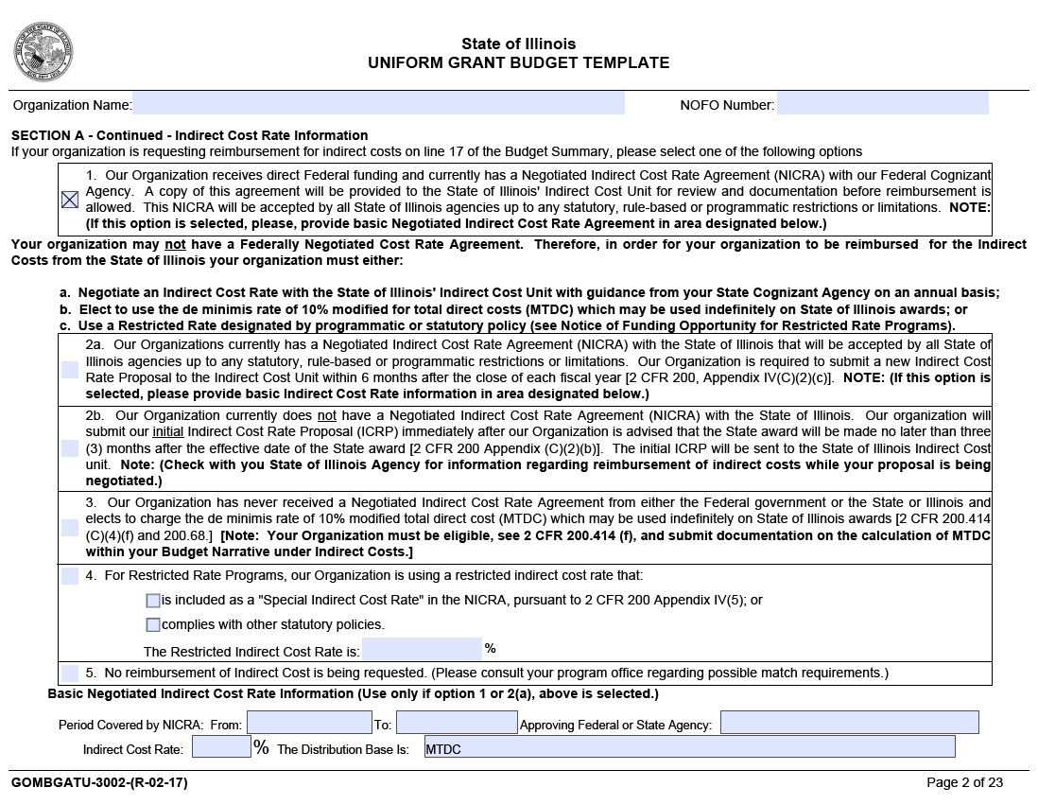
Indirect Costs
Negotiated Indirect Cost Rate (NICRA)
Negotiate an Indirect Cost Rate
De Minimis
Restricted rate by programmatic or statutory policy (Look in NOFO)

Slide 13
Line Items
Start in an excel spreadsheet and then move it into your UGB pdf— note that the decimal place rounding might take some finessing
Think through the math behind each item (i.e., office supplies, number of trips, salary, fringe)
Make sure you have the narrative ready
Even if your fiscal people are preparing this, they will need your narrative
Notes:
Scroll through the UGB and walk people through the different pieces

Slide 14
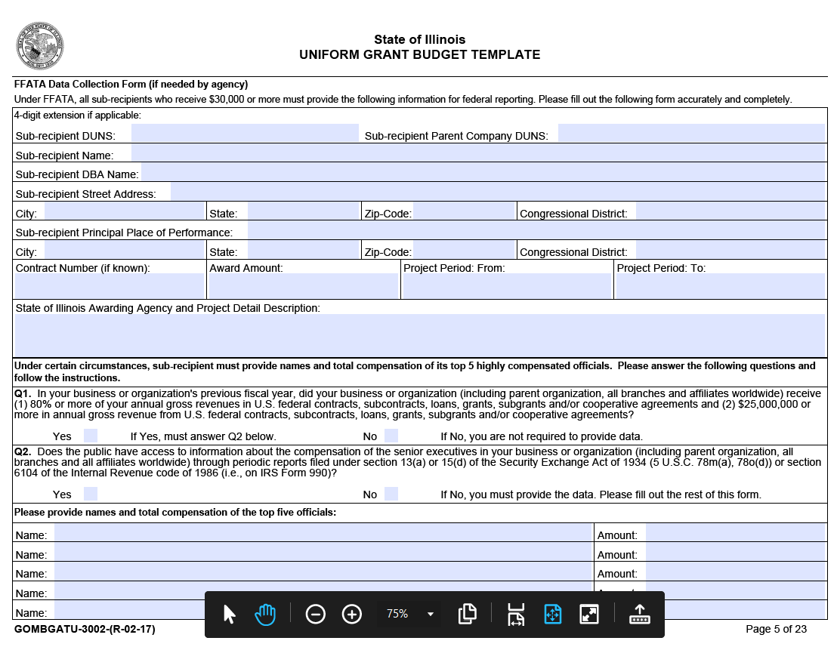
Sub-Recipients
Make sure you have all the details you will need from your sub-awardees!

Slide 15
03
Expenses & Line Items

Slide 16
Salary & Fringe
How many staff and how much time charged to this grant
Hiring new staff/creating new roles
Competitive/reasonable staff salaries (think through workforce shortage)
Union Rate
Compare to field
Fringe are benefits usually estimated as a portion of the salary (so you need your salary first)
Notes:
Indeed salary ranges https://www.indeed.com/cmp/Non-Profit-Organizations/salaries?aceid=&kw=adwords_c_9099621460_15516767951_&sid=us_googconthajpmax-_c__g_9021750&gclid=CjwKCAiAgvKQBhBbEiwAaPQw3MxumhYI4NJh_A8neBP2_PV1-vOwY5a3705ReNnzyjVSl3dUNirvChoCXRwQAvD_BwE

Slide 17
Worksheet Time!
Notes:
What are three things that your program needs to get out of your budget?

Slide 18
Other Program Costs
Rent/Utilities/Occupancy
Curricula
Technology
Subscriptions
Travel
Field Trips
Phone/Internet
Program Supplies

Slide 19
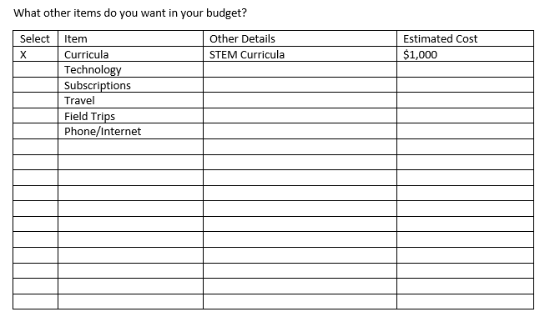
Worksheet Time!
Check off items you would want in your budget, describe them, and estimate cost.
Share ideas for grant expenses via the menti!
Notes:
Menti
What are some items you want to pay for with this grant

Slide 20
04
Budget Narrative

Slide 21
Budget Narrative
Need to have it, but not always a lot of points
Give it the amount of space it deserves– no more! (About a page)
Define your line items and says what you will use them for
Don’t need a ton of detail (i,.e., you can say STEM curricula and not know which one yet)
Use your line items to create the outline

Slide 22
Questions?

Slide 23
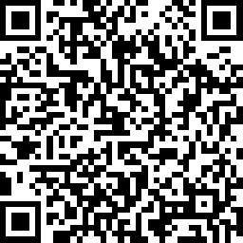
Evaluation
Notes:
https://www.surveymonkey.com/r/gwseries

Slide 24
Thanks!
Do you have any questions?
gillanin@actnowillinois.org
(312) 714-0182
Actnowillinois.org

