Slide 1
The Baby Fold-Community Schools

Slide 2
History and overview
*In collaboration with McLean County Unit District No 5 and United Way of McLean County, The Baby Fold became the Lead Partner Agency at Fairview Elementary in 2013
*Expanded to Cedar Ridge elementary in 2017
*Began partnership with Bloomington District 87 and expanded to Sheridan Elementary in 2019
*United Way funding ended in 2018 and funding is now shared between the school districts and The Baby Fold

Slide 3
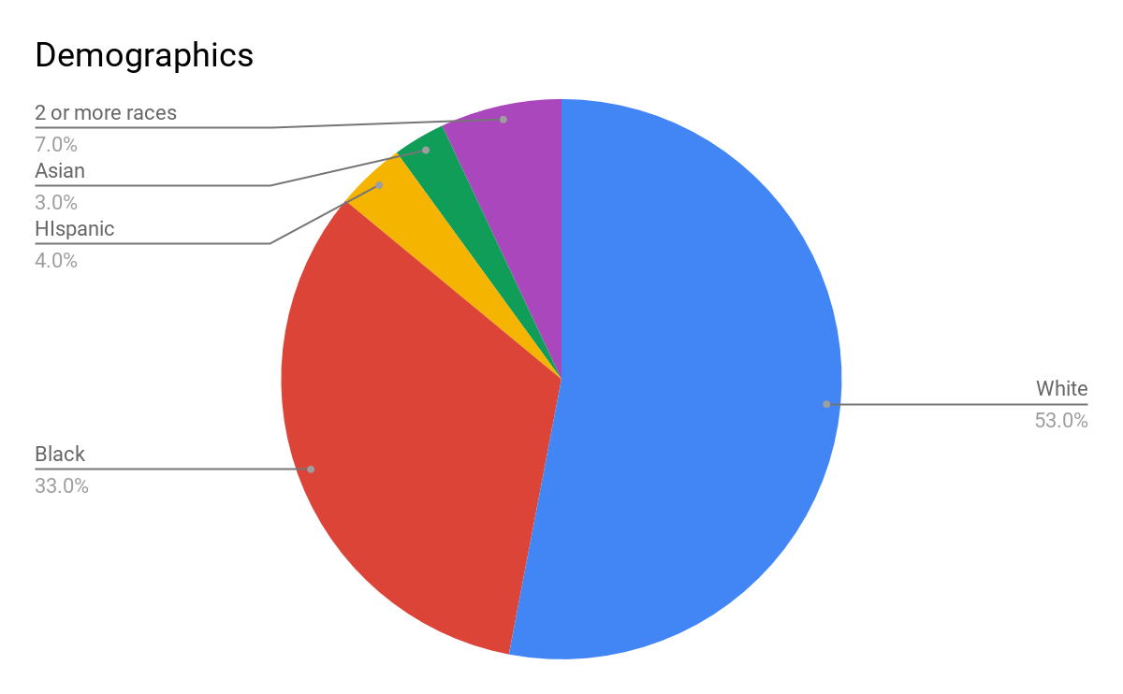
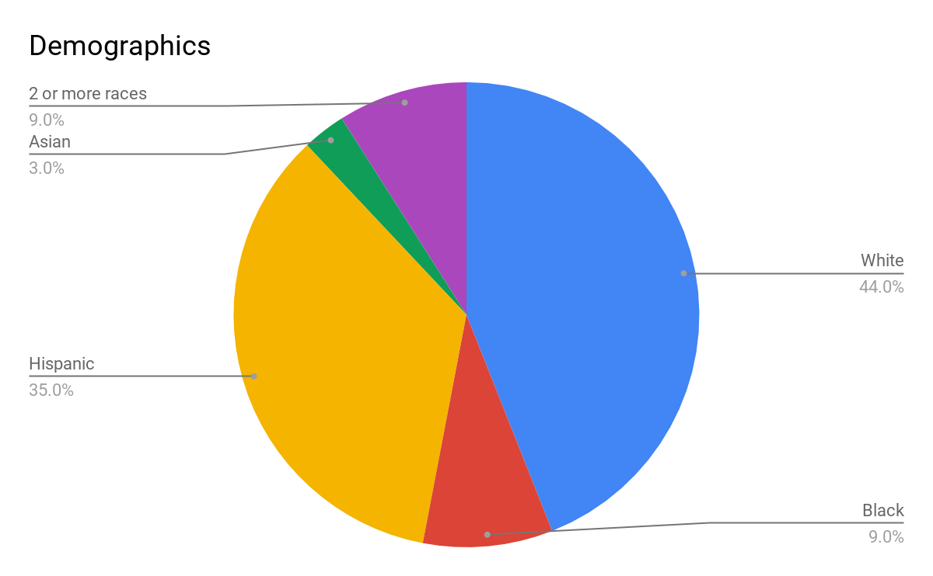
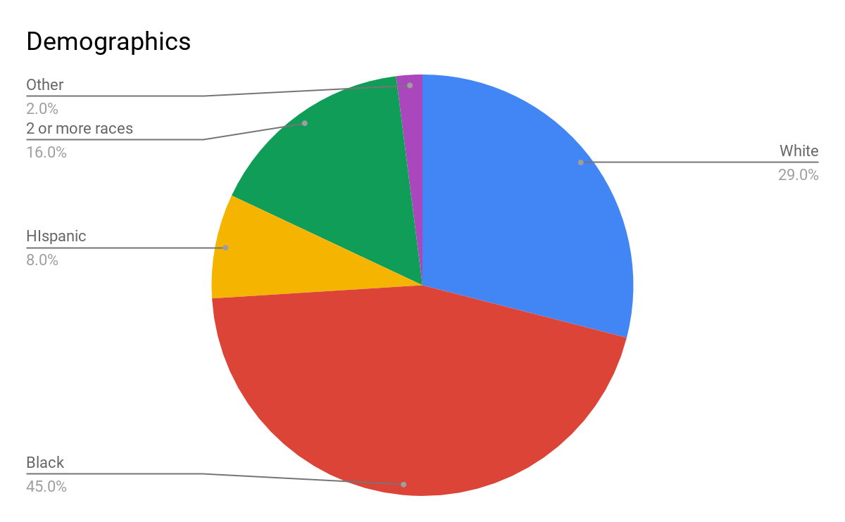
Sites and staffing
Fairview Elementary | Cedar Ridge Elementary | Sheridan Elementary
*On-site full-time CSC
*2 PFA classes
*300 students
*50% f/r
*on-site full-time CSC
*designated ell site
*500 students
*74% f/r
*on-site full-time csc
*375 students
*82% f/r
Information from 2019 IL State Report Card

Slide 4
Community school partners
*faith community
*Promise Council
*Childcare community
*COmmunity agencies

Slide 5
Covid-19 supports
*targeted needs assessments
*virtual family engagement
*linkage to virtual academic support
*increased trainings on trauma-informed practices
*collaboration with community agencies to provide comprehensive support (food, financial, spiritual, etc)

Slide 6
Racial Equity
*Culturally responsive language
*book studies for staff
*representation on the agency-led racial equity leadership team
*advocacy for equal access to education--particularly during covid-19 closure
*expanding classroom libraries

Slide 7
For more information visit:
https://www.thebabyfold.org/what-we-do/schools-education-services/community-schools/

