Slide 1
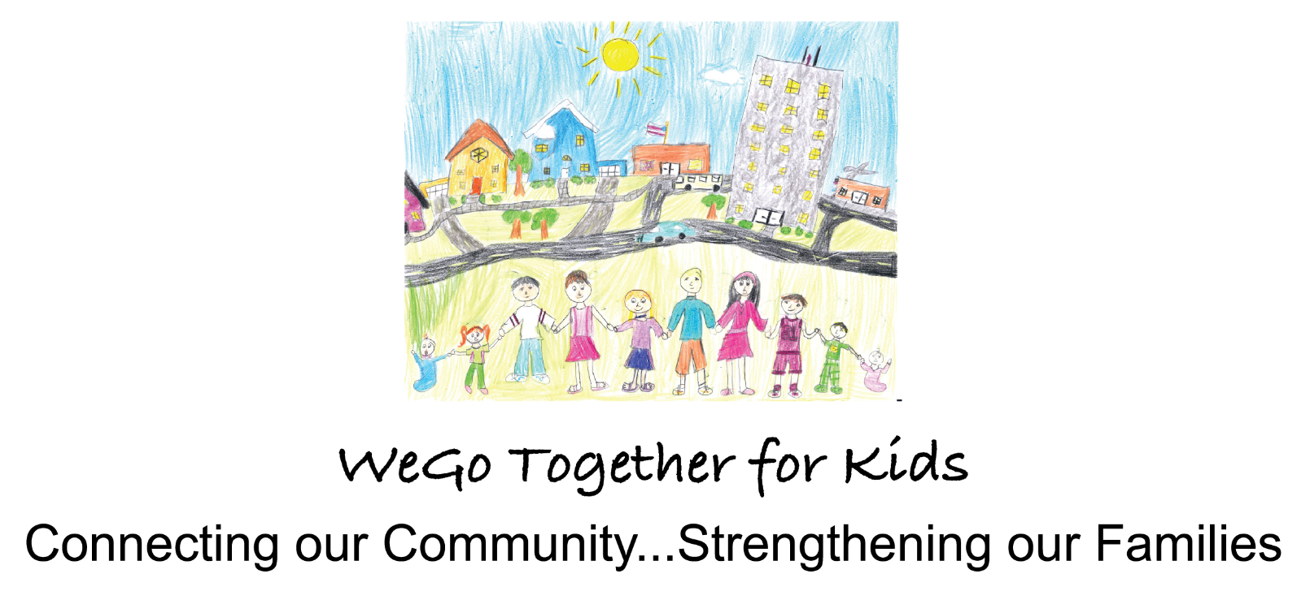
West Chicago Elementary School District 33
Community Schools Model
Joie Frankovich, LCSW MPH
Coordinator of Partnerships
October 6, 2020
Notes:
Students come to school with non-academic barriers that impact a child's ability to learn and how a CS model helps alleviate barriers through partnerships and programming.

Slide 2
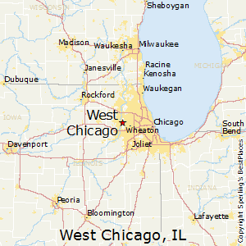
West Chicago, IL and ESD 33
Approx. 40 miles west of Chicago
27,000 residents
Very diverse!
53% Latinx
Resettled through World Relief
English Language Learners
Notes:
West Chicago is a suburb in DuPage County - 40 miles west of the city
About 27,000 residents and very diverse… over half Latinx, second/third most resettled community in DuPage County through World Relief, white middle-class

Slide 3
WeGo Together for Kids
Collective impact initiative that sits inside ESD 33
Over 60 community partners
Facilitates community schools efforts and blends funding resources to support community schools
Notes:
In WC we have a collective impact initiative - WeGo Together for Kids that sit inside D33
Over 60 community partners - these are just a FEW of them….
Because of where we sit, facilitate D33’s community schools efforts and ensure alignment to broader community goals and blend funding

Slide 4
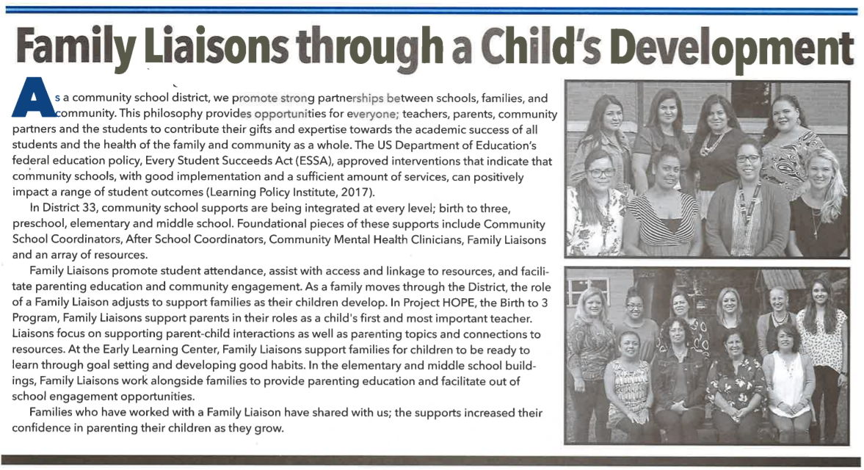
Staffing Model
Family Liaisons
Are part of school building teams
Provide direct support with families
Main roles are:
Attendance monitoring
Parenting Education
Access and linkage to community resources
Community School Coordinators
Are part of District Administration
Supervise Family Liaisons
Oversee systems and development of the Community School Model
Collaborates with local community partners
Notes:
In D33, our community partners are the foundation to successfully supporting students and their families
However, our D33-based staff are how a lot of the work is developed and partners are brought into the schools
I am the Coordinator of Partnerships and oversee all community school supports for D33 and facilitate WeGo Together for Kids - sit on Cabinet
3 Community School Coordinators that are District Administrators
Supervise Family Liaisons and develop building based systems - ensure continuity across the District
Family Liaisons in every school - direct service providers
Attendance monitoring, parenting education, access and linkage to resources

Slide 5
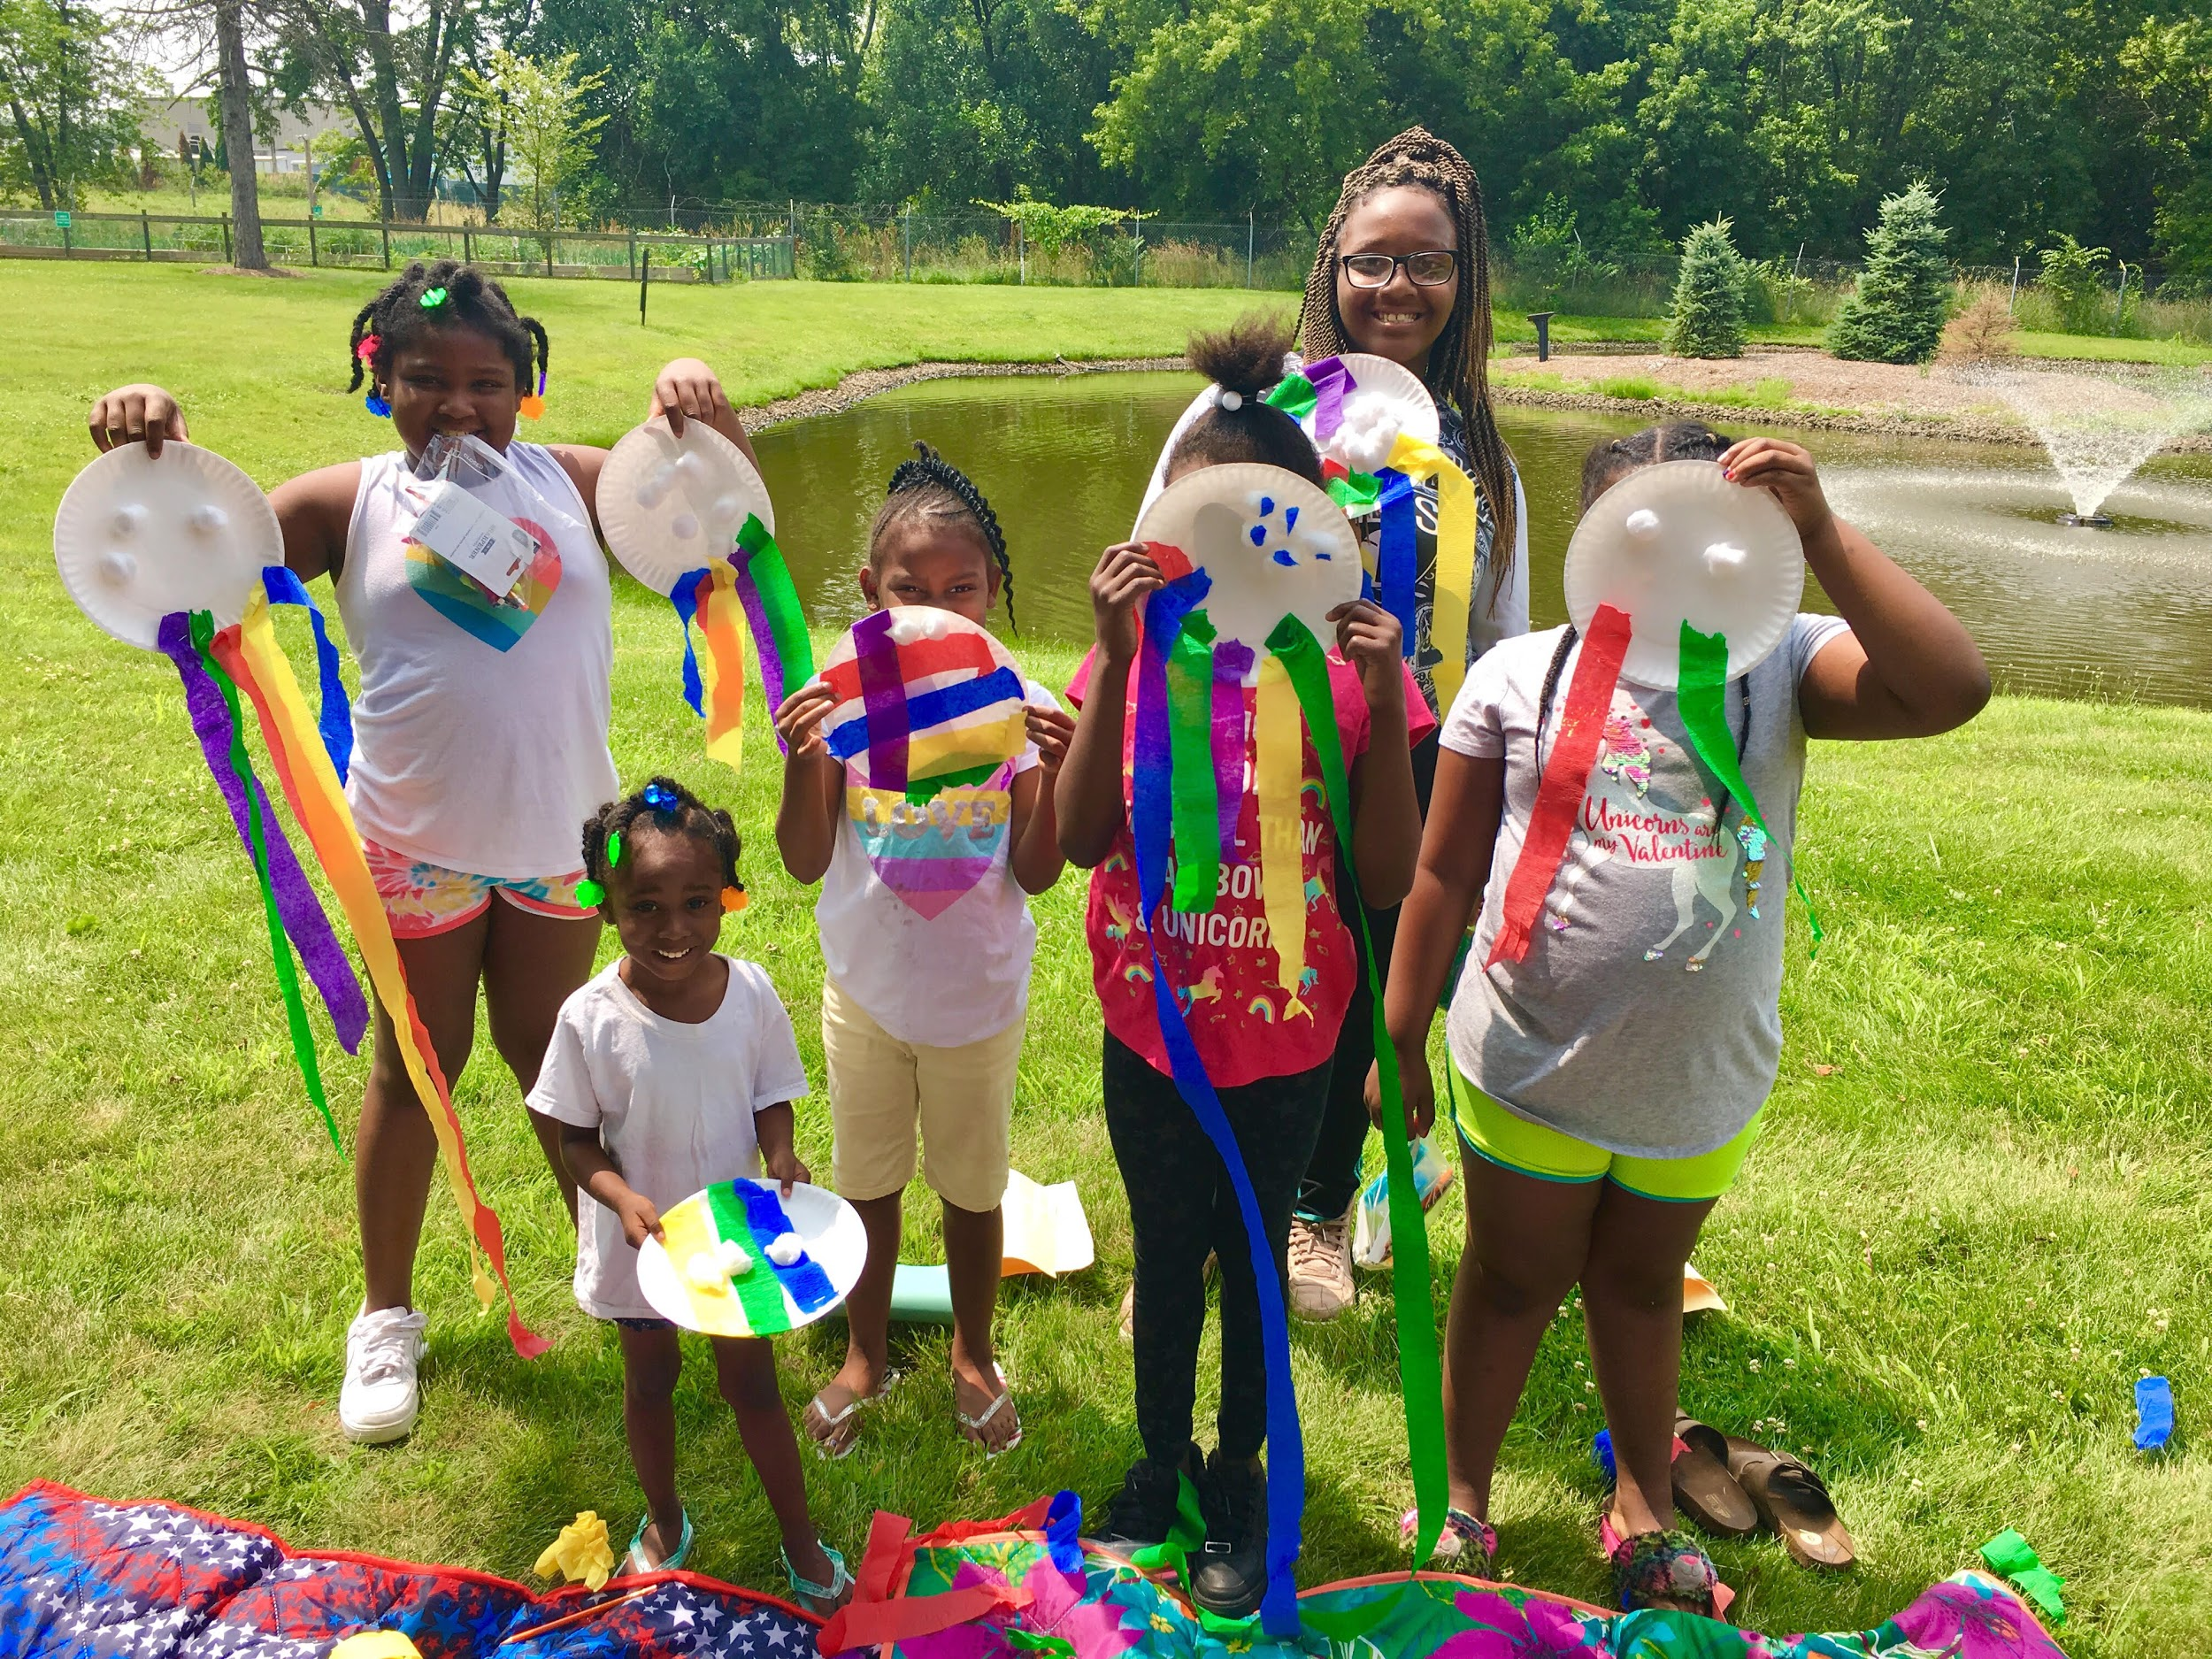
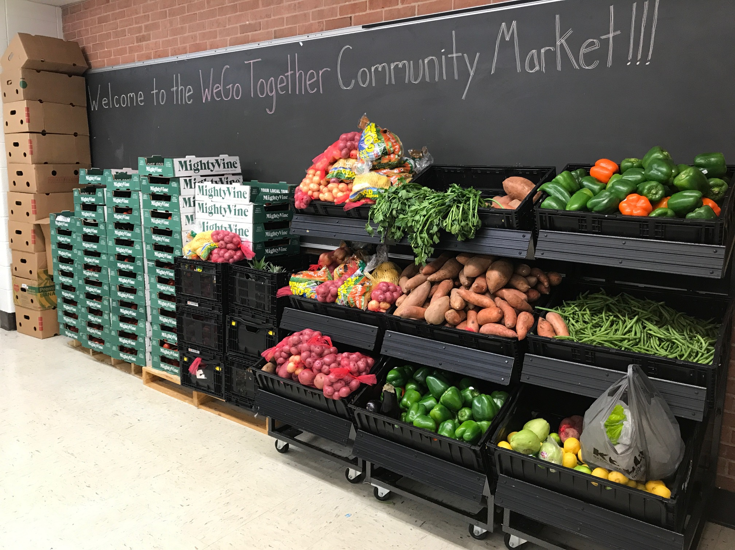
Examples of Resources/Programming
ESL classes for parents
Child Development
Family Zumba classes
Afterschool Programming
Afterschool clubs (nutrition and fitness)
Community Mental Health Services
Holiday Gift Program
Back to School Events (School Supplies)
WeGo Together Community Market
Becoming A Man (BAM)
Attendance support
Summer Play groups
Parent Cafes
Parenting Education/workshops
COVID-19 response
Home deliveries
Financial assistance
Family Liaison support

Slide 6
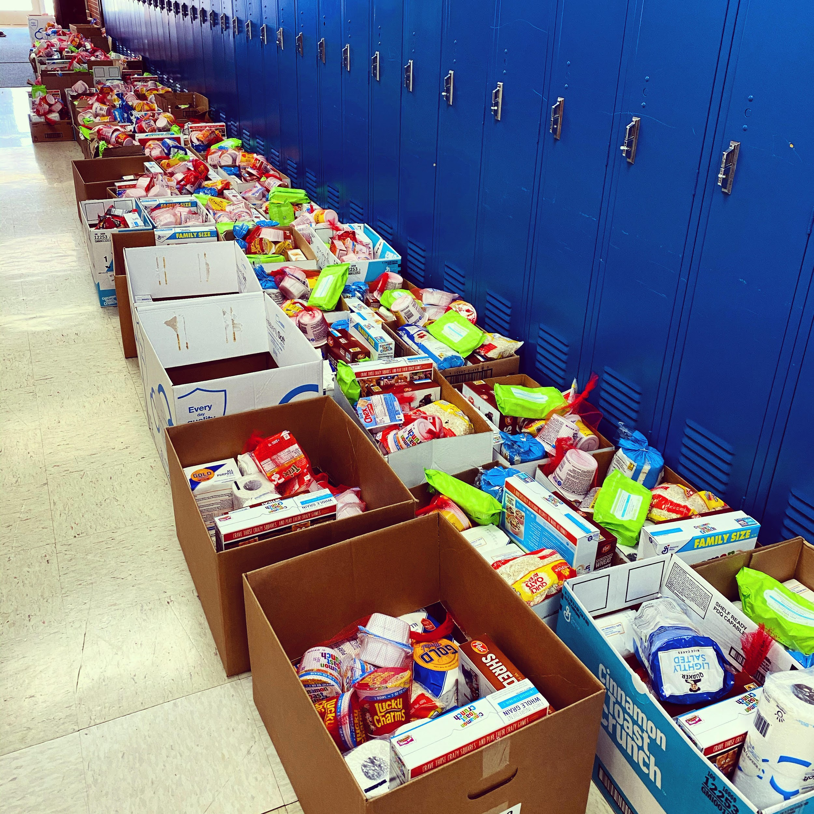
COVID-19 Response Efforts
Home deliveries of essential items
641 deliveries made - 3,547 individuals supported
Financial assistance for mortgage/rent and utilities
$43,240 to date
Shift to virtual programming
Family movement classes
Driving permit classes
Adult computer literacy and ESL classes
Notes:
West Chicago has been the most negatively impacted community in DuPage County per capita
Many Latinx residents - CDC tells us people of color are more likely to be impacted due to essential worker status, built home environments, etc.
Started with constant surveying of community to understand how people were being impacted the types of resources they would find to be helpful
Developed home delivery system to bring essential items (diapers, wipes, masks, first aid kits, toilet paper, etc.) to resident’s homes
All contactless through volunteers from community churches (WBC, St. Andrew, Renewal)
Began to bring in additional response funding (CCRF, Latino Fund, etc.) and offer financial assistance for household bills
Began to shift usual programming to virtual, while also understanding some programming needed to pause as families were burning out with screen time - needed to prioritize other efforts

Slide 7
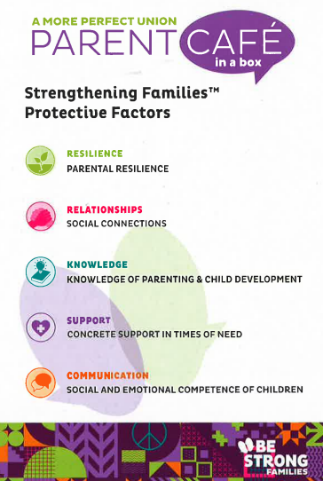
Racial Equity
Parent cafe - A More Perfect Union
Social justice and parenting
Supporting D33’s equity committee
Ensuring a complete perspective and supporting the whole child
Notes:
Parent cafe facilitated by Ciara Thomas, LMS CSC, and team:
This parent cafe will focus on social justice and parenting, allowing parents to explore the border context for parenting in a complicated and often unjust world. By having the conversations, we hope to
Create a sense of community
Promote understanding of different perspectives.
Recognize that we don’t have control over the circumstances our children will face.
By doing so, it will allow us to
Embrace love and compassion across differences
Transform our attitudes and beliefs by learning from other’s perspectives and experiences.
Deepen our understanding of the social and political contexts, situations, and events that are present in our family’s lives and the lives of others.
Embody a safe space for participants to share their truth, values and lived experiences.
Foster relationship building.
Expand consciousness.
Move towards a more just, more equal, more free, more caring and more prosperous America.

Slide 8
I never thought going to the school and asking for help would get assistance.
-D33 Parent

Slide 9
THANK YOU!!
Joie Frankovich
Coordinator of Partnerships
frankovichj@wego33.org
@JosephinaWeGo33

