Slide 1
Community Schools in Illinois: An Effective Strategy to Address Equity, Health, and Academics in Our Schools

Slide 2
Agenda
Overview of the Report
Remarks from Rep.Theresa Mah
Community School Panelists
Josephina M. Frankovich, LCSW MPH, Coordinator of Partnerships West Chicago Elementary School District 33, WeGo Together for Kids
Amber Brooks, Director of Community and Afterschool Programs, Youth Guidance
Rebecca Kinsey, Community Schools Coordinator at the Baby Fold (Bloomington-Normal)
Laura Beavers, Manager of Prevention & Early Intervention Services at the Baby Fold (Bloomington-Normal)

Slide 3
Let’s be Social!
Please feel free to post on social media about today’s event!
Facebook: @AfterschoolforChildrenandTeensNow
Twitter: @ACTNowCoalition
#CommunitySchoolsinIL

Slide 4
Who is ACT Now?
We are statewide organization that provides advocacy and professional development supports to afterschool programs and community schools.
We are part of a nationwide network of statewide afterschool networks with a counterpart in all 50 states.
Actnowillinois.org
Policy
Quality
Professional Development
Community Schools
STEM

Slide 5
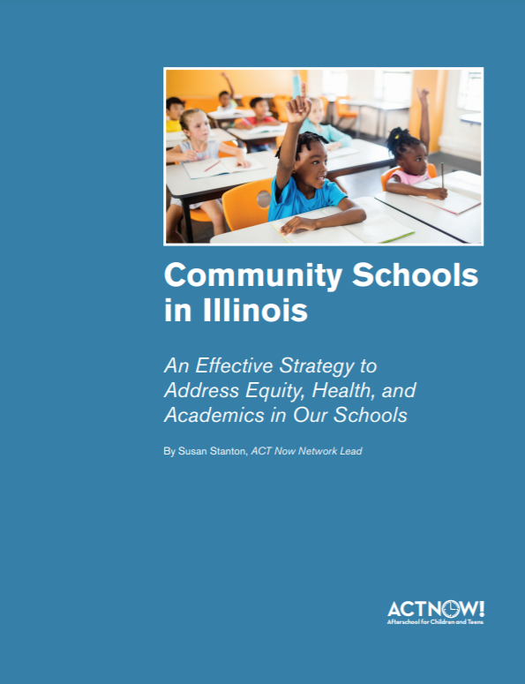
Inside the Report
http://www.actnowillinois.org/wp-content/uploads/2020/09/Community-Schools-in-Illinois.pdf
Nationwide research
Statewide data collected from 18 community school systems
Report contents
What community schools look like throughout the state
How they make an impact
What we need for this model to grow
How this model has responded to the pandemic and issues of racial injustice
Notes:
Community schools exist throughout our state and make an impact for the families and youth most in need
Community schools also have their history based in Illinois
This report tells the story of what community schools look like throughout the state, shares how they make an impact, points out what we need for this model to grow, and shares what this model has responded to the pandemic and issues of racial injustice

Slide 6
What Are Community Schools?
Community schools are a specific model of education and community organizing, different from just a neighborhood school. Community schools are public schools that partner with families and community-based organizations to provide well-rounded educational opportunities and supports for students’ school success using the school as a hub.
The Four Pillars:
Integrated Student Supports
Expanded and Enriched Learning Time and Opportunities
Family and Community Engagement
Collaborative Leadership and Practices

Slide 7
Where are Community Schools in Illinois?
Chicago
Suburbs: North Chicago, West Chicago, Skokie, Evanston, Bensenville, Bolingbrook, and Palatine
Downstate: Champaign, Bloomington, Peoria, and Springfield

Slide 8
Pillar One: integrated Student Supports
Youth experience many challenges that inhibit school-day learning
Community schools provide additional supports to meet the full needs of students, so they can focus on learning, including
Medical, dental, mental health, tutoring supports, parent education classes, job training, housing assistance, and nutrition programs
Leads to improved attendance, behavior, social well-being, and academic achievement
Improve mathematics achievement, reading achievement, school behavior problems, and school attachment
Notes:
Youth experience many challenges that inhibit school-day learning, such as food and housing insecurity, inadequate health care access, exposure to violence, the need to be a child-care provider for other family members, and many times language and immigration concerns.
In middle and upper-income communities, access to these resources contributes to a positive learning environment. Integrated supports recognize that low-income students benefit from the same
Meeting the full needs of students in this way leads to improved attendance, behavior, social well-being, and academic achievement.
Studies also show that integrated student supports improve mathematics achievement, reading achievement, school behavior problems, and school attachment.

Slide 9
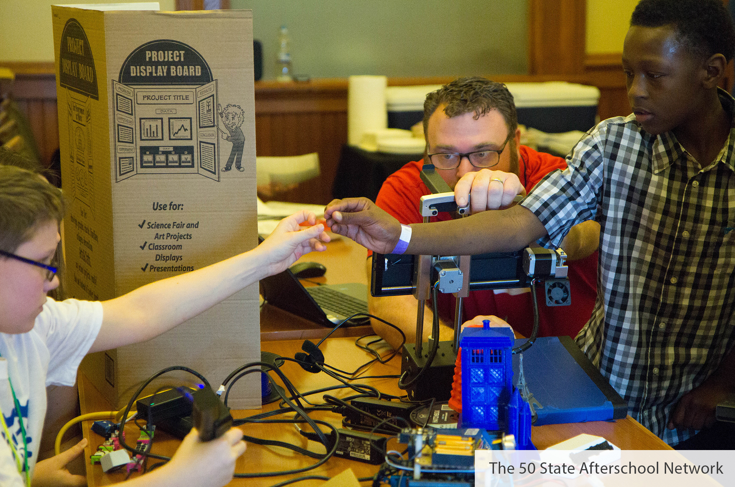
Pillar Two: Expanded and Enriched Learning Time and Opportunities
Types of Services
Impact
Services outside the school day, including afterschool programs, before school care, summer learning activities, or winter and spring break activities
Services during the school day, such as specialists that focus on workforce readiness, the arts, or special projects
Community schools in Illinois show:
Improved grades
Greater student interest in school
Improved attendance
Students feel more prepared for college and career
Greater completion of homework
Improved academic performance
Increased graduation rate
Improved standardized test scores
Notes:
In more affluent areas, many youth have access to additional learning experiences to supplement the school day, including support for struggling learners or enrichment to build upon and expand on what students learn in school. Community schools often offer afterschool and summer learning experiences to support students with these needs and close this opportunity gap.

Slide 10
Pillar Three: Family and Community Engagement
Types of Services
Impact
Parent support of student learning, family and community partnership in school, and family and community organizing
Workshops and classes for parents and families and connect these stakeholders to essential services that help their family to thrive
Positive relationships
Attendance
Academic achievement
School Climate
Substance abuse
Student mobility
Crime

Slide 11
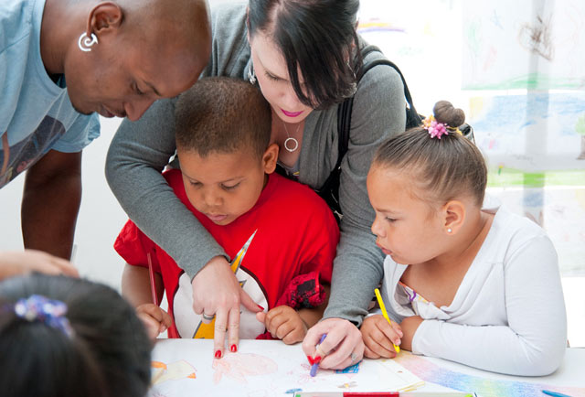
Pillar Three: Family and Community Engagement
North Chicago Community Partners: 94% of teachers say the community schools model increased parent and/or family engagement.
YMCA of Metropolitan Chicago: 85% of parents using their program say that community schools made them more closely connected to their child’s school.
WeGo Together for Kids of West Chicago: increased the number of parents participating in a parent education opportunity by 42% and increased the number of families connected to community resources by 95.7%.
80% of parents involved in Enlace Chicago’s community schools indicated that they had acquired a deeper understanding of how they could assist their children’s learning and become involved in school activities.
Community schools run by the National Museum of Mexican Art found that 80% of parents involved in ESL, computer, and student support courses have successfully acquired those skills.

Slide 12
Pillar Four: Collaborative Leadership and Practices
The essential piece that bring all the other community school pillars together
Working together and sharing decisions and responsibilities toward a commonly held vision or outcome for the school
Examples of Collaborative Leadership Practices
School governance and program planning, such as responsibility for assessing school context and needs, resource distribution, and continuous improvement
Coordination of services and supports
Practices and systems to maintain constructive relationships between school staff and members of the community

Slide 13
Models of community Schools
Community-Based Organization Led
Lead Partner Agency
Runs afterschool programs and coordinates services
School-District Led
School district as backbone
Outside Community Building
Instead of services in the building, an outside community organization houses service
Volunteer/Philanthropy Focus
Emerging Models
Resource coordinator
Schools often run afterschool and identify partners or partners with outside contractors
Sends services into the school
Not funded through public dollars
Strong partnerships with private entities to support programming
Just starting out
May not be fully funded
May have one resource coordinators for multiple schools

Slide 14
Responding to COVID-19

Slide 15
Responding to Covid-19
Connecting families to essential goods and services
Academic enrichment and child care
Cash assistance
Family engagement and support

Slide 16
Addressing Issues of Racial Injustice
Grounded in the principles of equity and the need to provide students with the opportunities necessary to succeed in school and life
Racism and police brutality continue to gravely affect these communities
Community schools have led protests and advocacy conversations about reform
Addresses the opportunity gap and ensures all youth are set up for success
Notes:
community schools are essential to achieving equity for the communities most affected by racial injustice. Too often low-income students of color do not have access to resources needed to succeed in school and life. This is a stark opportunity gap from their higher-income peers who may have greater access to adequate physical and mental health care, tutors, career exploration opportunities, and academic enrichment opportunities. These opportunities are essential for a well-rounded education and healthy life. Community schools provide a way to address these needs and help to grow and shift in response to future community needs. Investing in community schools will help to work towards equity in the communities around Illinois that need it most.

Slide 17
Community Schools Funding
Funding
Federal
21st CCLC
Full-Service Community Schools Grant
State
Teen REACH
Private/In-Kind
Local
Chicago Full Service Community Schools

Slide 18
The Future for Community Schools in Illinois
Sustainable Funding
Not enough funding currently
Funding streams were not meant for community schools
Office for Community Schools
Community schools are also fiscally efficient and provide an excellent return in social value on investments for these schools of up to $15 for every dollar invested.
returns derive from improvements in education, employment, health outcomes, and reductions in crime and welfare.

Slide 19
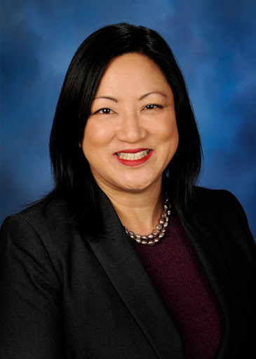
Illinois State Representative Theresa Mah

Slide 20
Community School Panelists
Josephina M. Frankovich, LCSW MPH, Coordinator of Partnerships West Chicago Elementary School District 33, WeGo Together for Kids
Amber Brooks, Director of Community and Afterschool Programs, Youth Guidance
Rebecca Kinsey, Community Schools Coordinator at the Baby Fold (Bloomington-Normal)
Laura Beavers, Manager of Prevention & Early Intervention Services at the Baby Fold (Bloomington-Normal)

Slide 21
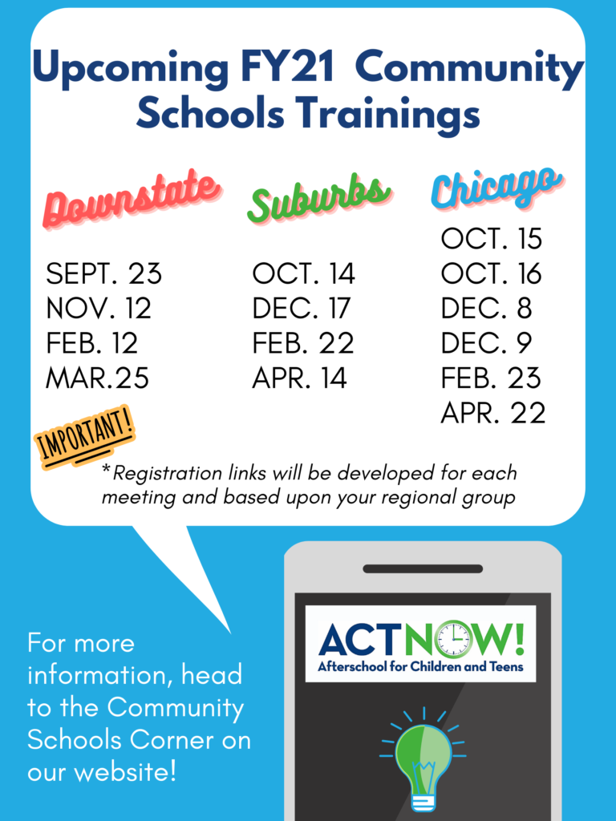
Stay Engaged!
Celebrate Lights On Afterschool October 22nd! http://www.actnowillinois.org/lights-on-afterschool-2020/
Join our community school events throughout the year! http://www.actnowillinois.org/community-schools-corner/

Slide 22
Questions?

Slide 23
Thank you
Susan Stanton, ACT Now Network Lead, stantons@actnowillinois.org, 312-877-0725

