Slide 2
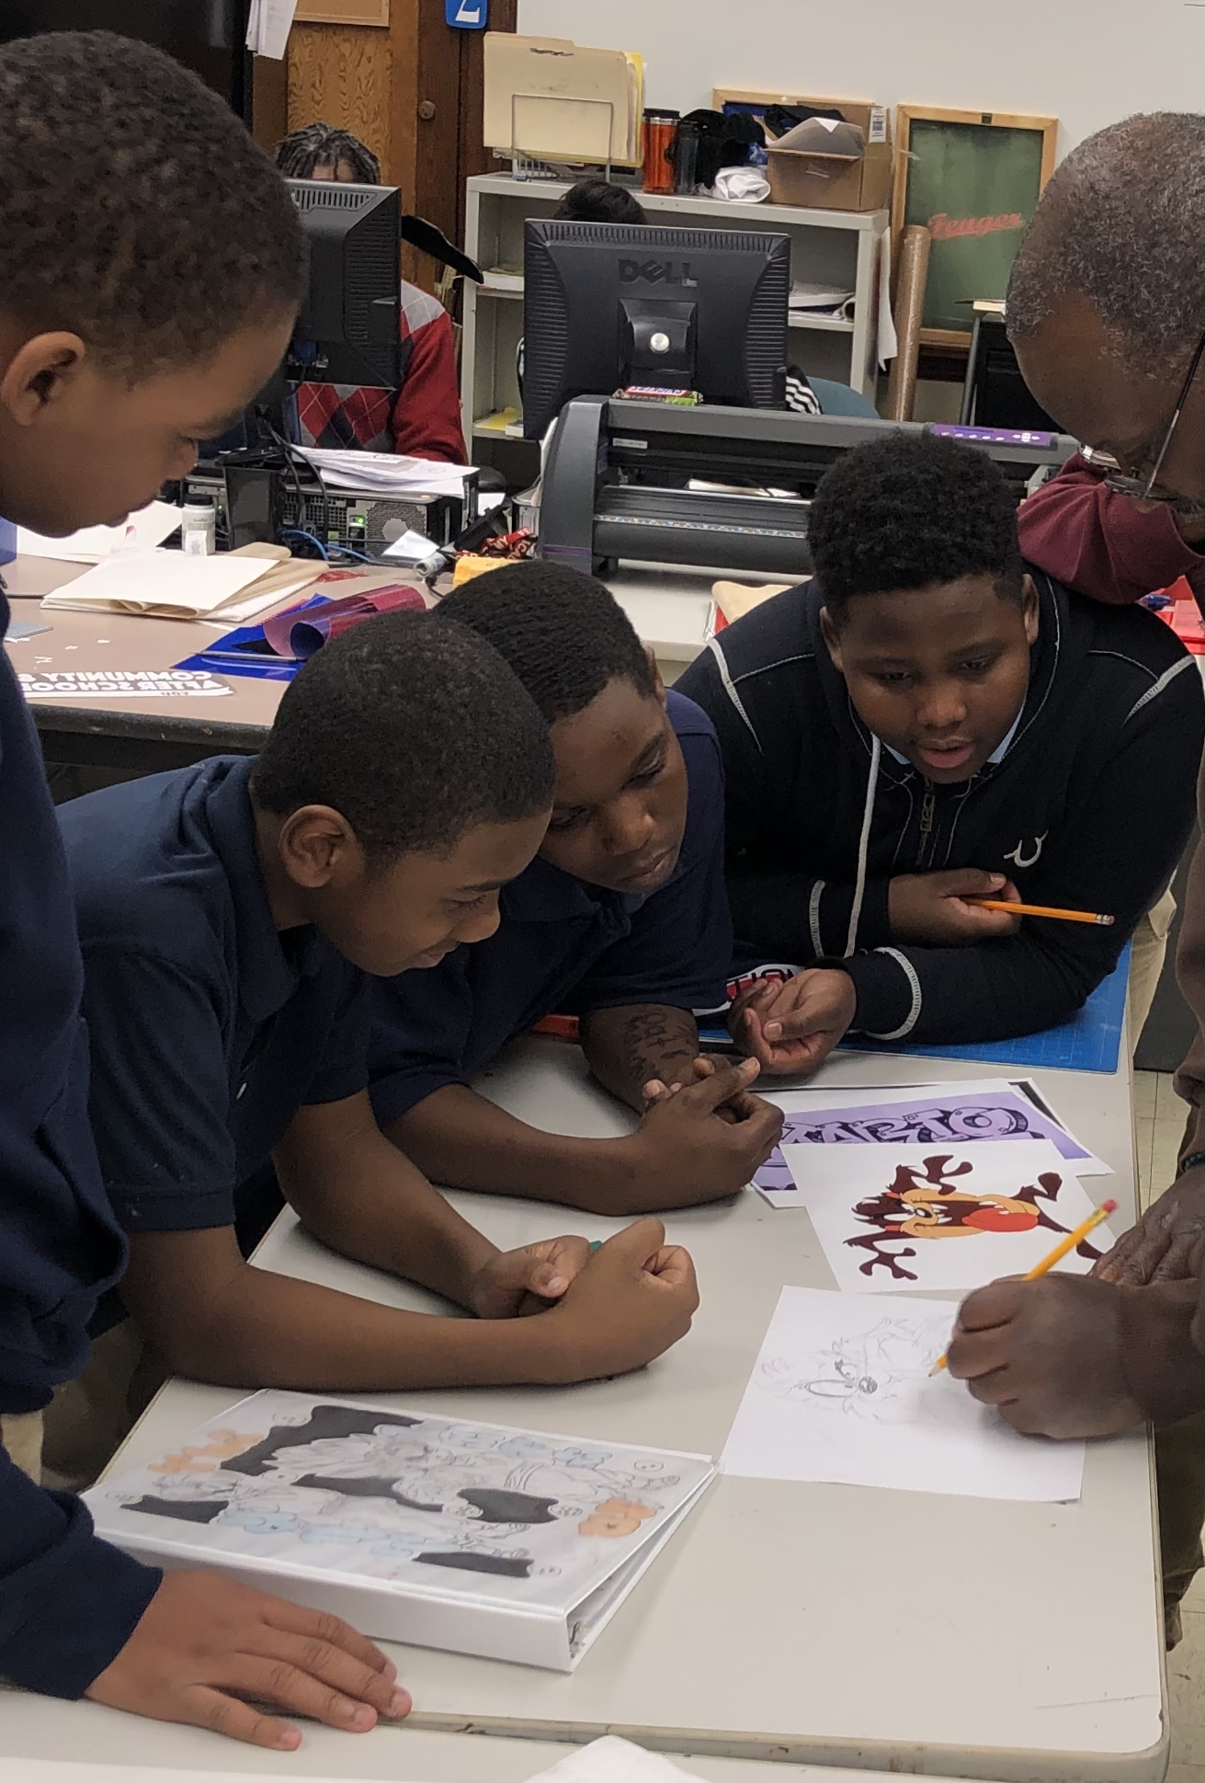
Youth Guidance Community Schools
Full-Service Community Schools address barriers to student learning by providing school-based academic and social interventions. Operating beyond traditional school hours, community schools erect supports for positive student development and provide wrap-around academic and social services to students and their parents, as well as members of the community.

Slide 3
Sites We Serve
21 Community Schools across the Chicagoland area.
Last year we serviced 2,657 elementary and high school students.
Focus on improving school climate and supporting adolescent development, targeting areas such as critical thinking, collaboration, goal setting, and self regulation.
Support the uncovering of unique strengths through exposure and inclusion of youth voice into programming.

Slide 4
YG COVID Response
Needs Assessments were conducted to determine family needs:
Cash Assistance
Technology Support
Access to PPE
Agency wide 4,000 families completed the Rapid Response Needs Assessment. 900 indicated that there was a critical need in their home.
Now implementing the Needs Assessment as a part of the enrollment process to support families.

Slide 5
COVID & Community Schools Programming
YG out of school time programs transitioned to a virtual platform to support students and families:
Virtual Tutoring
Drop-in SEL Supports
Virtual Enrichments

Slide 6
Wellness Wednesdays
Our Community Schools team recognized the opportunity to extend additional supports to parents to support their social and emotional well-being during this time.
Wellness Wednesdays focus on a topical training weekly. Trainings are live and pre-recorded and help to give parents tools to support them emotionally during this time as well as strategies to help make the learning environment at home successful.

Slide 7
Learning Pods
Through partnerships with community stakeholders, we are able to offer small learning pods for students whose family members may be essential workers.
Learning pods operate from 8am-3pm and offer supervised social-distanced learning supports during virtual learning.

Slide 8
Understanding the Impact of Racial Injustice
When we identify under-resourced schools and rally robust services and programing through our Community and After School programs, we are making schools a better resource to the community and advancing equity.
Reserving space for staff and youth to process the impact of racial injustice and trauma.
Creating opportunities for youth to channel positive means of expression:
Art
Poetry
Dance
Music

