Slide 1
Q4 Downstate Community School Networking and Training Event
ACT Now

Slide 2
YOU ARE DOING A GREAT JOB! I AM SO GRATEFUL THAT I GET TO SUPPORT SUCH STELLAR CHANGEMAKERS!
Notes:
Is your program
Furloughing employees
Laying off employees
Asking employees to take leave
Is your program offering afterschool snacks or supper?

Slide 3
Agenda
Policy Updates
Federal
State
How Programs Are Responding
COVID-19 Response Resources
Needs Assessment

Slide 4
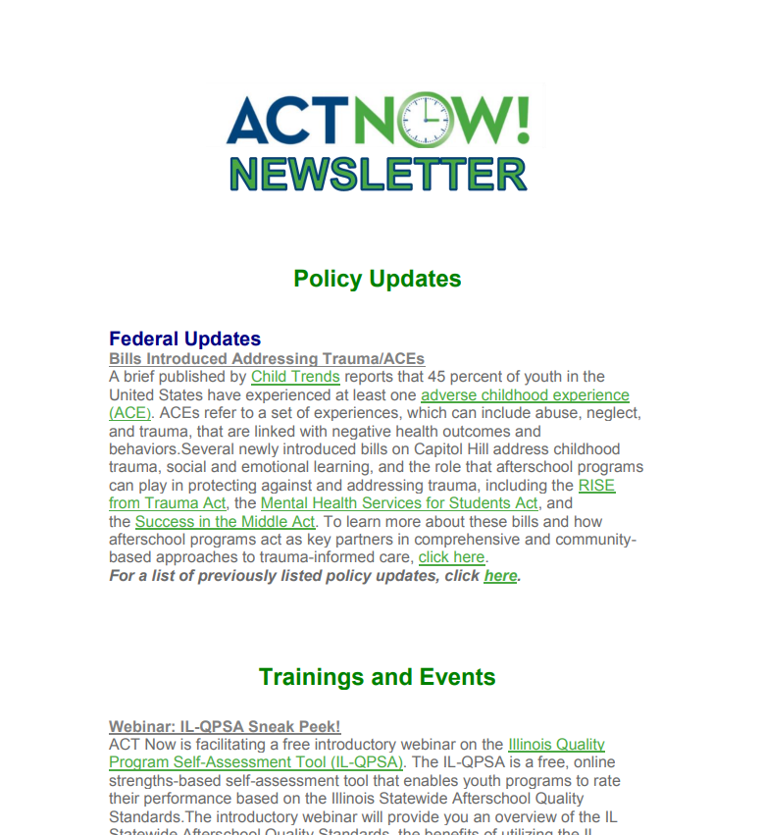
Newsletter
http://www.actnowillinois.org/join-act-now/

Slide 5
Policy Updates

Slide 6
Federal Updates
Corona Virus Aid, Relief, and Economic Security Act (CARES Act)
The law establishes a State Education Stabilization Fund funded at $30.75 billion with funds mostly split between Emergency Relief funds for Higher Education ($14.25 billion) and Elementary and Secondary School ($13.5 Billion). The stabilization fund also provides about 10 percent ($3 billion) that can be allocated at governors’ discretion for grants to local districts that the State Education Agency deems most impacted by COVID-19 to continue educational support and ongoing district operations
Within the Elementary and Secondary School Relief Fund,
$13.5 billion of this amount is set aside for K-12 education allocated to states based on Title I formula in the most recent fiscal year
Specific activities for this funding called out to address the pandemic include:
Planning and implementing activities during the summer and afterschool
Planning and coordinating meals
Online learning and other educational services
Purchasing technology
Mental health support
The Child Care Development Block Grant (CCDBG) is appropriated an additional $3.5 billion in grants to states for immediate assistance to child care providers to prevent them from going out of business and to otherwise support child care for families, including for healthcare workers, first responders, and others playing critical roles during this crisis.

Slide 7
Federal Updates
CARE Act Loans Information: In collaboration with Spectrum nonprofit services and the Charles Stewart Mott Foundation, the 50 STATE AFTERSCHOOL NETWORK has created a document regarding the CARE Act Loans programs. Learn about the Emergency & Normal Economic Injury Disaster Loan (EIDL) program and the Paycheck Protection Program (PPP).
Applications for the Paycheck Protection Program will open on Friday, April 3, 2020, through current Small Business Administration (SBA) lenders. SBA anticipates high demand for these funds, and in preparation, encourages you to reach out to your bank to determine whether they are an SBA lender and have tailored guidance for their customers and also to begin filling out your application and gathering any supporting documentation. A factsheet that outlines the eligibility requirements as well as the information to gather is available from the U.S. Department of the Treasury. The application form can be found here.

Slide 8
State Updates
Schools statewide are closed until at least April 30th
Districts should be participating in remote learning now, but what that looks like varies greatly
Many upcoming RFPs are up in the air

Slide 9
How is your program responding to the COVID-19 crisis?
What does staffing look like?
Are you doing remote services or programming?
How are you determining and meeting the full needs of families?

Slide 10
COVID-19 Response Resources

Slide 11
Name | Link | Cost | Notes
Facebook Live / Messenger | www.facebook.com | Free | Unlimited viewership; most people has Facebook
GoToMeeting/ GoToWebinar | https://blog.gotomeeting.com/coronavirus-disruptions-and-support/ | Free for three months immediately | Recorded/live webinars; up to 100 participants;
Google Suite | https://cloud.google.com/blog/products/g-suite/helping-businesses-and-schools-stay-connected-in-response-to-coronavirus | Free and accessible until 7/1/2020 | Hangouts, Classroom, Drive included; up to 250 participants per call
Microsoft Teams | https://www.microsoft.com/en-us/microsoft-365/blog/2020/03/05/our-commitment-to-customers-during-covid-19/ | Free | Real-time collaboration with Office Apps; up to 250 participants per call
Remind | https://www.remind.com/plans/ | Free (Basic Plan) | Basic messaging, translation, up to 150 participants
Skype | https://www.skype.com/en/ | Free | Free conference calls, no download necessary; compatible on many devices
WebEx | https://www.webex.com/ | Free | 100 participants; screen sharing; personal break out rooms
Zoom | https://zoom.us/docs/ent/school-verification.html?zcid=1231&_ga=2.137396464.1181102350.1584362642-447969645.1561063027 | Free | 40 minute limit is being lifted for K-12 educators ; whiteboard access

Slide 12
Community Survey
English Word: http://www.actnowillinois.org/wp-content/uploads/2020/03/COVID-19-Survey-1.docx
Spanish Word: http://www.actnowillinois.org/wp-content/uploads/2020/03/COVID-19-Survey-Spanish.docx

Slide 13
Our Webpage
http://www.actnowillinois.org/covid-19-resources/

Slide 14
Virtual PD: Family Engagement
ACT Now has developed a three-hour series of family engagement training to improve family engagement in out-of-school time.
Participants in this training will dive into the layers family engagement, develop a model of evaluation, and craft a systematic strategy to high-quality and evidence-based family engagement. You will receive ready-to-go family engagement resources to use in your program!
You can register for individual webinars or for the entire series.
Part I: What is Family Engagement and What are Our Vision and Values? April 9th, 10:00-11:00
Part II: Introducing a Family Engagement Framework and Recognizing the Importance of Language April 23rd, 10:00-11:00
Part III: Family Engagement Common Barriers and Tangible Resources May 4th, 10:00-11:00
Each webinar is $10. Please contact VibberE@actnowillinois.org to inquire about large group pricing.

Slide 15
Virtual PD: Cultural Competency
We will also be launching a Cultural Competency training series. We anticipate launching this in early May. If your program would like to start on this series sooner, please contact Vibbere@actnowillinois.org now!

Slide 16
Questions

Slide 17
Next Steps
Fill out our survey for next year https://docs.google.com/forms/d/1LfRiP8skoA5sGVHKyenlOszOeOcyrKRdvfHRop6dSEY/edit
Respond to the evaluation for this call: https://docs.google.com/forms/d/1r5CV9OPGH03nvV2jJktNn1ZlOJ-BQmpyCSdM5ECB2wY/edit

